Slide 1
The Wonders of Physics
2018
35th Anniversary
Celebration!

Slide 2
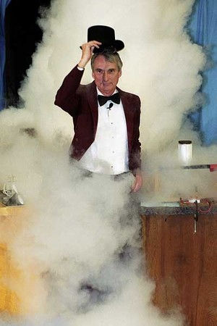
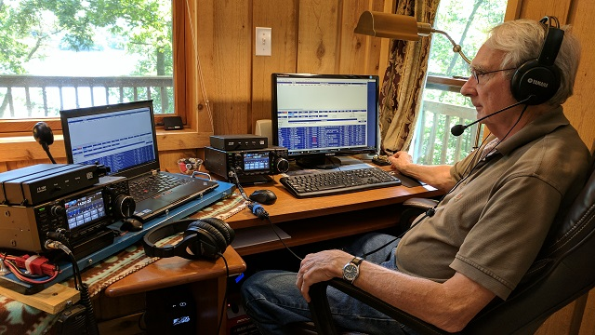
Meet the cast: Clint Sprott
Dr. Sprott is from Memphis, TN
He’s an Emeritus Professor of Physics at UW
He was an amateur radio operator in the 1950s, and that’s how he became interested in physics!

Slide 3
When was the first public radio broadcast in Wisconsin?
1902
1917
1933
1928
That’s why we are celebrating the 100th anniversary this year!

Slide 4
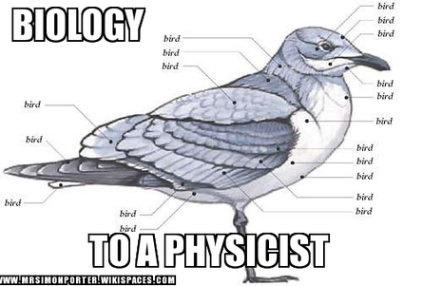

Slide 5
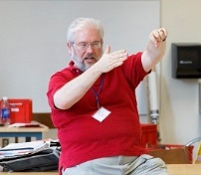
Meet the cast: Mike Randall
Mike was the former Senior Outreach Coordinator for The Wonders of Physics
President of “The Physics Experience” (ask him about doing physics shows for you!)
He used to design sensors for space shuttle engines and other rockets!

Slide 6
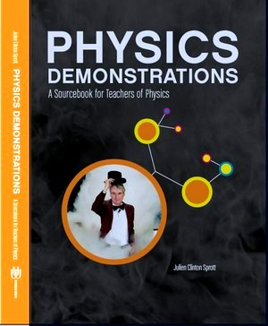
Physics Demonstrations: A sourcebook for teachers of physics
Professor Clint Sprott’s book is a great resource for any science teacher
It contains detailed descriptions of 85 physics demonstrations used in The Wonders of Physics
Videos for the demonstrations are online at: http://physicsdemonstrationsvideos.com
It is available on amazon.com for $49.95

Slide 7
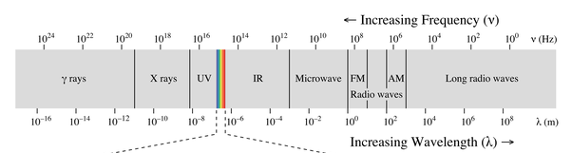
Which kitchen appliance uses a form of radio waves?
Toaster oven
Coffee maker
Refrigerator
Microwave
Microwaves are just a bit smaller than FM radio waves.

Slide 8
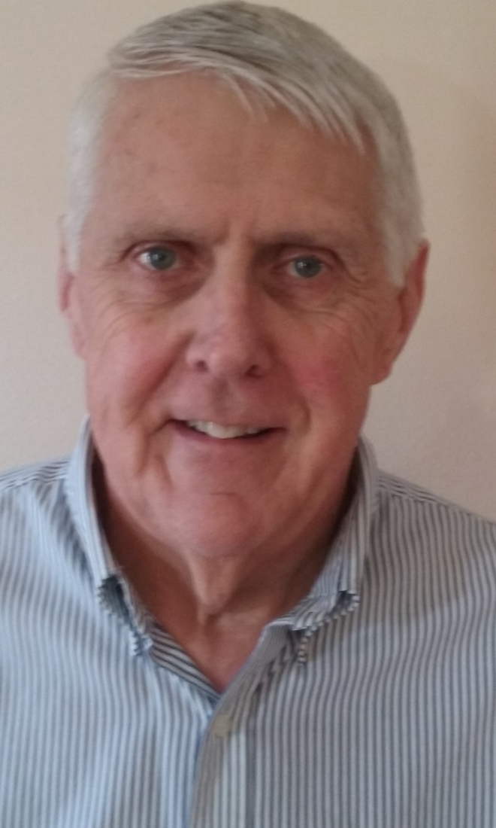
Meet the cast: Terry Craney
Mr. Craney was a professor of physics and math in Green Bay, WI
He has his private pilot’s license – and during the exam, he actually flew backwards because of strong headwinds!

Slide 9
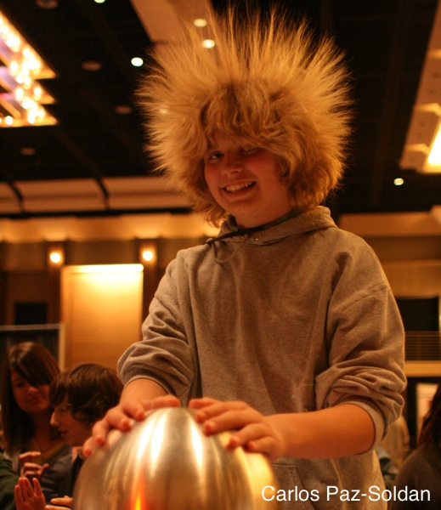
The Wonders of Physics traveling show can visit your school!
Thousands of traveling shows have been presented to 100,000+ students in Wisconsin and 36 other states
The Wonders of Physics shows make a great science assembly program for school groups of all grade levels
Visit our website for more info: http://wonders.physics.wisc.edu

Slide 10
How long is an average AM radio wave?
10 feet
5 inches
300 yards
250 feet
That’s why AM radio stations can be detected farther away than FM ones.

Slide 11
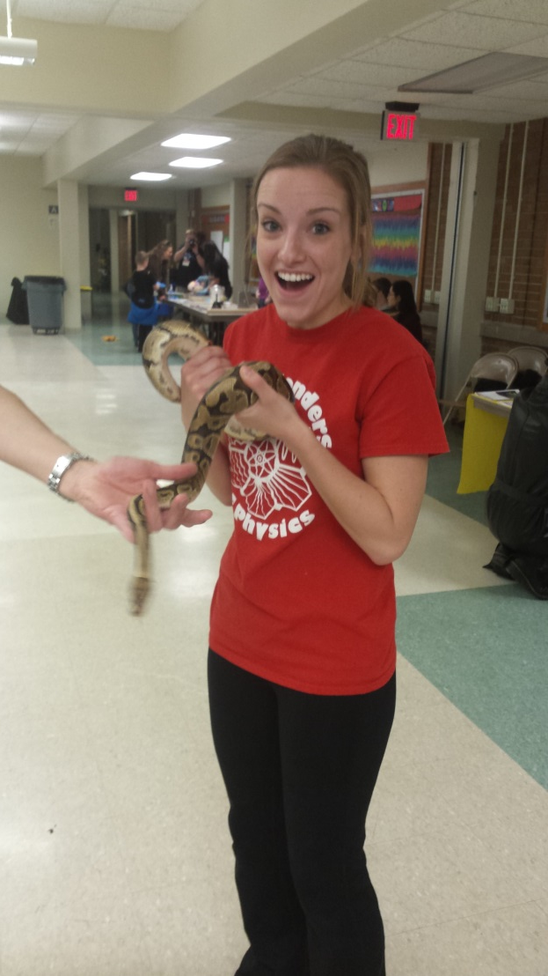
Meet the cast: Emily Ehlerding
Emily is a graduate student in the Medical Physics department
She’s from Decatur, IN
If she were to host a radio show, it would be one with old-school country music.

Slide 12
What’s the world record for most weather forecasts read in 1 minute on the radio?
68 cities
30 cities
87 cities
52 cities
A DJ in Pakistan read the forecast high temperatures for 68 cities in one minute on August 18, 2012.

Slide 13
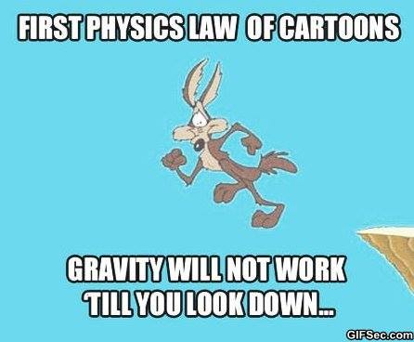

Slide 14
Meet the Cast: Michael Winokur
Dr. Winokur is a professor of physics at UW
His research is in condensed matter
Check out those glasses! →

Slide 15
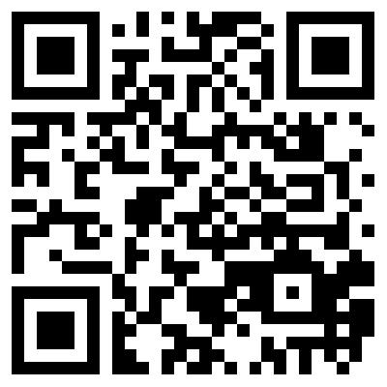
Donations are welcome!
Donations help us continue to present The Wonders of Physics year after year!
Donation bins are located outside of the lecture room
Donate online! Visit wonders.physics.wisc.edu and click the Donate tab

Slide 16
How long is the world-record radio marathon by a single DJ?
101 hours, 15 minutes
205 hours, 2 minutes
26 hours, 32 minutes
53 hours, 47 minutes
A DJ in Italy stayed on the radio for 205 hours… we hope that he slept somewhere in there.

Slide 17
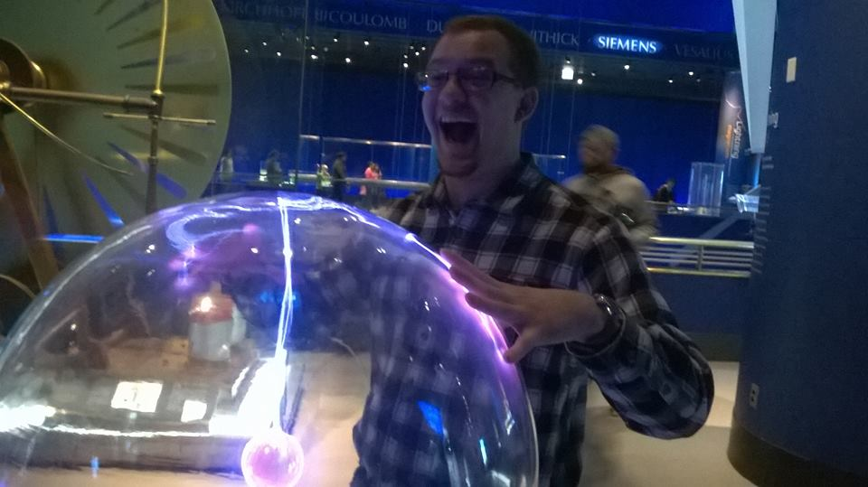
Meet the cast: Ryan Norval
Ryan is a graduate student studying plasma physics.
He wants to make plasma devices for satellites or medical devices.
If he won the lottery, he’d buy a boat and become a pirate.

Slide 18
Don’t miss the physics fair!
Hands-on activities and lab tours
Meet scientists and students
Free and open to the public. No tickets required.
http://wonders.physics.wisc.edu/physics-fair.htm
Saturday, February 17th
from 11 am to 4 pm

Slide 19
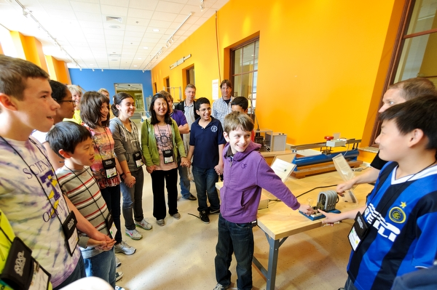
After the show…
Visit the Wonders of Physics information table and purchase a t-shirt, DVD, or science toy!
Visit the Ingersoll Physics Museum

Slide 20
Meet the cast: Kimberly Palladino
Dr. Palladino is an assistant professor of physics here at UW
She’s from Yardley, PA
Her research involves finding neutrinos in detectors one mile underground
She’s been to all 50 states in the USA!

Slide 21
You Matter
Unless you are multiplied by the speed of light squared
Then You Are Energy
$$E=mc^{2}$$

Slide 22
How long is an average FM radio wave?
10 feet
5 inches
300 yards
250 feet
Compare that to the wavelength of visible light –
0.000015 inches!

Slide 23
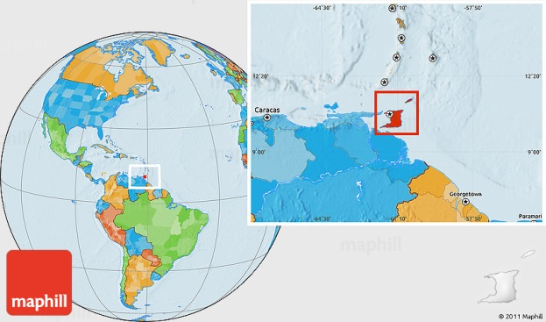
Meet the cast: Akire Trestrail
Akire is a graduate student in Medical Physics
He’s from Trinidad and Tobago

Slide 24
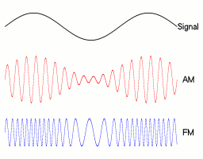
What does “AM” stand for in radio?
Ante meridiem
After midnight
Amplitude modulation
Awesome music
In AM radio, the amplitude of the wave is changed. In FM, it’s the frequency that changes.

Slide 25
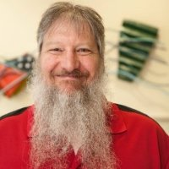
Meet the cast: Peter Weix
Peter is the Chief Operations-Facilities Engineer for the Madison Symmetric Torus.
He thinks it would be awesome to be a locomotive engineer. Choo-choo!
He used to work for a company that helped the space shuttle program!

Slide 26
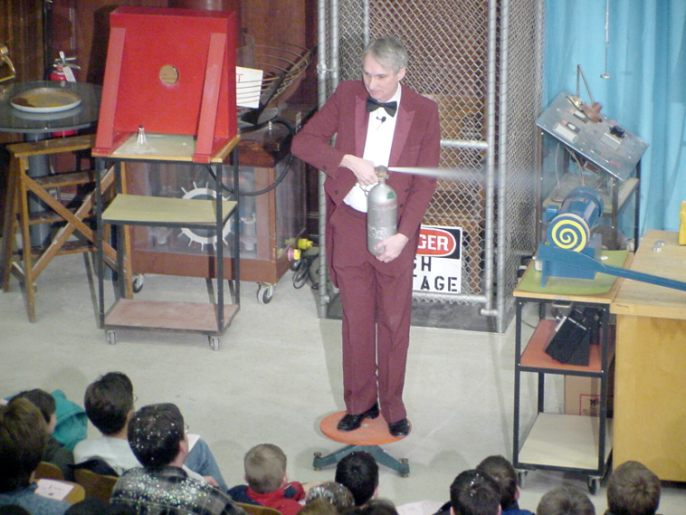
The Wonders of Physics shows are available on DVD and online!
Order any of the past 33 years of shows on DVD, or order the whole set!
Click the Gallery tab on our website to watch all of the past shows online
DVDs are available at the Wonders of Physics information table

Slide 27
Meet the Cast: Steve Narf
Mr. Narf is the one in charge of ALL of our awesome demonstrations for these shows!

Slide 28
How long is the world-record underwater radio broadcast?
10 hours, 15 minutes
3 hours, 48 minutes
7 hours, 54 minutes
5 hours, 25 minutes
The broadcast took place with the DJ in a huge water tank, complete with sharks and sting rays!

Slide 29
Funding support
Please visit http://wonders.physics.wisc.edu and click the Donate tab to find out how you can make a difference!

