Slide 1
Welcome to the Wonders of Physics 2015!

Slide 2
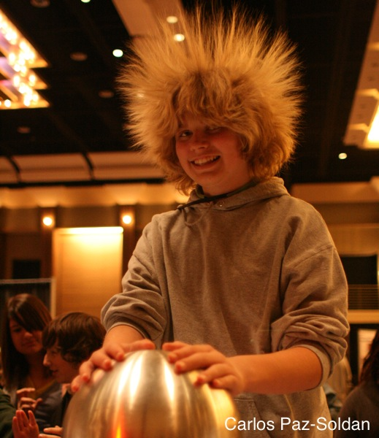
The Wonders of Physics Traveling Show can visit your school!
Thousands of traveling shows have been presented to 100,000+ students in Wisconsin and 36 other states
The Wonders of Physics shows make a great science assembly program for school groups of all grade levels
Visit our website for more info:
http://wonders.physics.wisc.edu

Slide 3
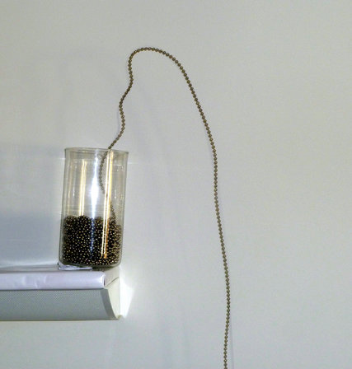
Is this possible?

Slide 4
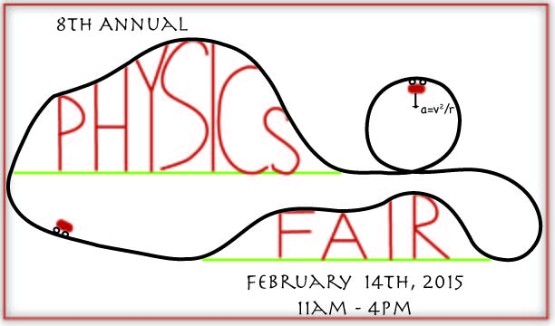
Don’t miss the Physics Fair!
Hands-on activities and lab tours
Meet scientists and students
Free and open to the public. No tickets required.
http://wonders.physics.wisc.edu/physics-fair.htm

Slide 5
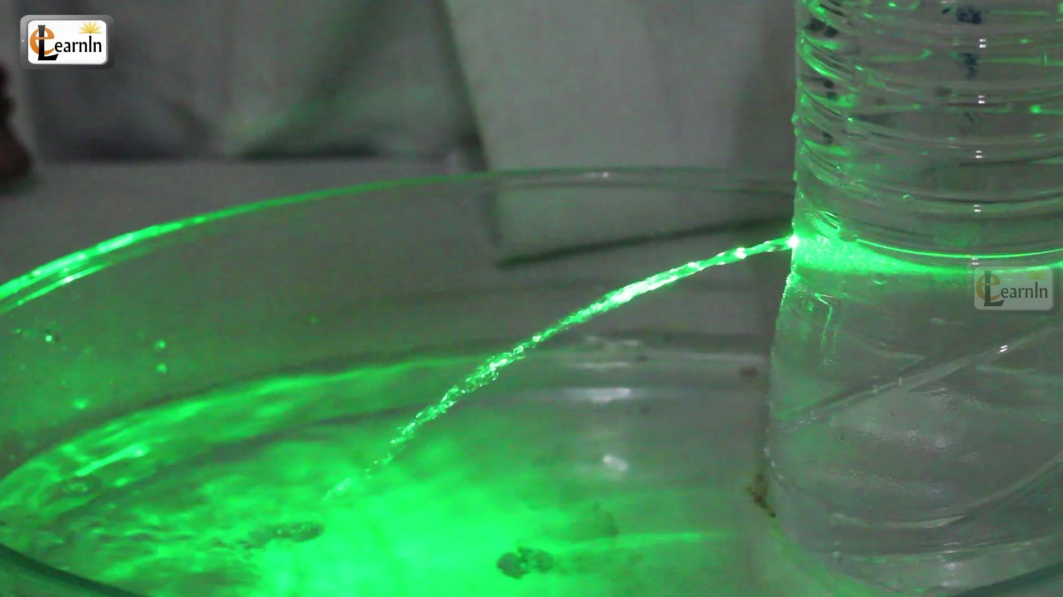
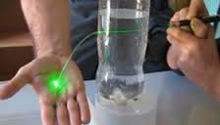
Is this possible?

Slide 6

Donations are welcome!
Donations help us continue to present The Wonders of Physics year after year!
Donation bins are located outside of the lecture room
Donate online! Visit wonders.physics.wisc.edu
and click the Donate tab

Slide 7
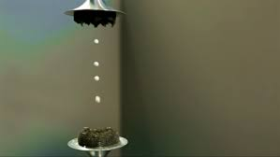
Is this possible?

Slide 8
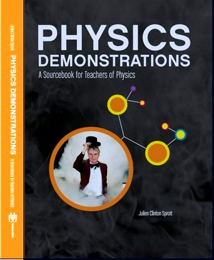
Physics Demonstrations: A Sourcebook for Teachers of Physics
Professor Clint Sprott’s book is a great resource for any science teacher
It contains detailed descriptions of 85 physics demonstrations used in The Wonders of Physics
It is accompanied by two DVDs showing all 85 demonstrations presented to a live audience
It is available on amazon.com for $42

Slide 9
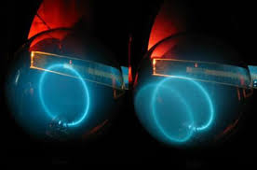
Is this possible?

Slide 10
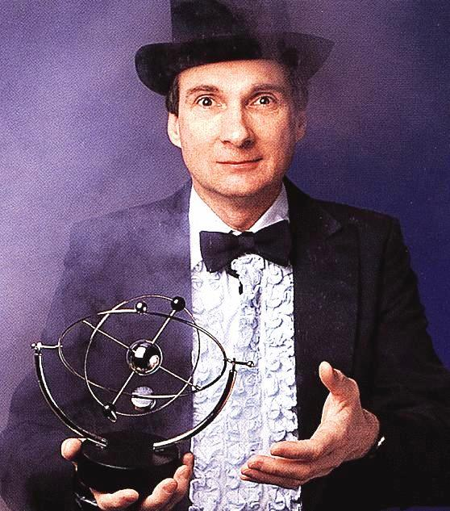
Professor Clint Sprott
Since 1984, Professor Sprott has presented The Wonders of Physics
He became a Professor of Physics at UW-Madison in 1973
His research is in plasma physics and chaos

Slide 11
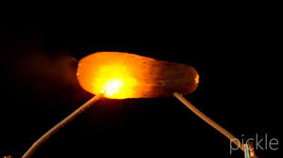
Is this possible?

Slide 12
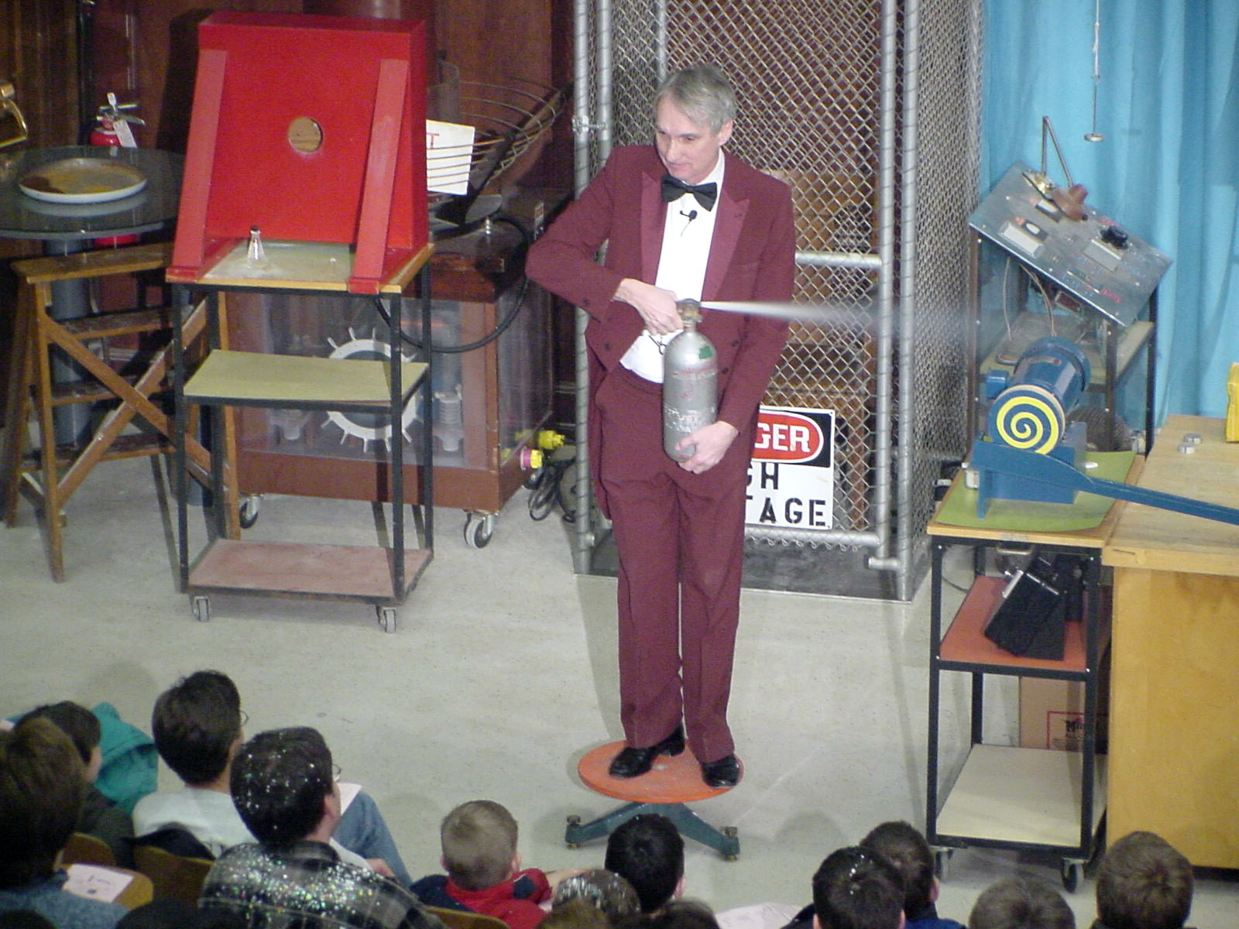
The Wonders of Physics shows are available on DVD and online!
Order any of the past 31 years of shows on DVD, or order the whole set!
Click the Gallery tab on our website to watch all of the past shows online
DVDs are available at the Wonders of Physics information table

Slide 13
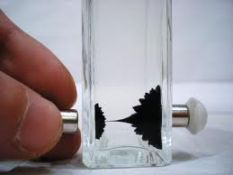
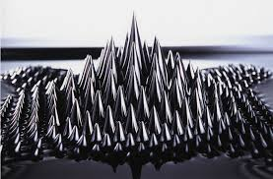
Is this possible?

Slide 14
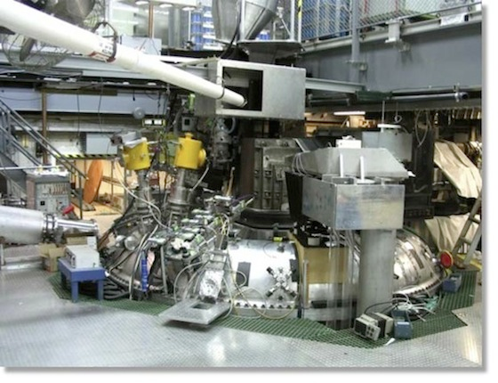
Madison Symmetric Torus
The Madison Symmetric Torus (MST) produces hot plasma for research in plasma physics and fusion power generation, the energy source of the sun.
Plasma is created when five giant capacitor banks dump 20 million watts of power in 1/10th of a second! That’s enough juice to light up a small town (very briefly).
Every time the MST fires, it makes a loud 'WOMP', scaring the heck out of unsuspecting students as they walk by!
The MST is located right here in Chamberlin Hall.
Visit http://plasma.physics.wisc.edu for more information.

Slide 15
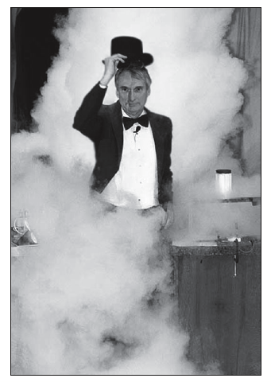
The 32nd year of
The Wonders of Physics!
The first Wonders of Physics shows were in 1984
The shows were inspired by UW Chemistry Professor Bassam Shakhashiri’s “Once Upon a Christmas Cheery” lectures
Through 2014, Professor Sprott and friends have presented 267 shows to 93,880 people!

Slide 16
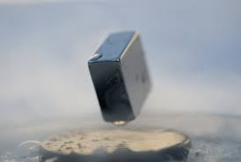
Is this possible?

Slide 17
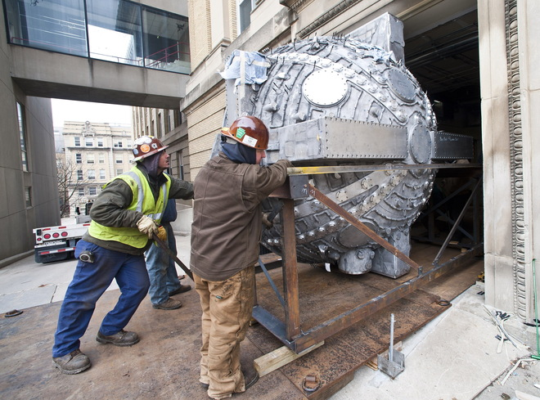
Madison Plasma Dynamo Experiment
A new UW-Madison research project to simulate the superheated gases that form the sun's magnetic field.
The hollow aluminum sphere, built by four Wisconsin companies, weighs 11,000 pounds. It was built to heat gases to 500,000 degrees Fahrenheit.
It will help researchers understand why the sun occasionally spews out particles that affect the Earth, knocking out satellites and even taking down power grids!
The sphere now occupies a new two-story lab in Sterling Hall.
Visit http://plasma.physics.wisc.edu for more information.

Slide 18
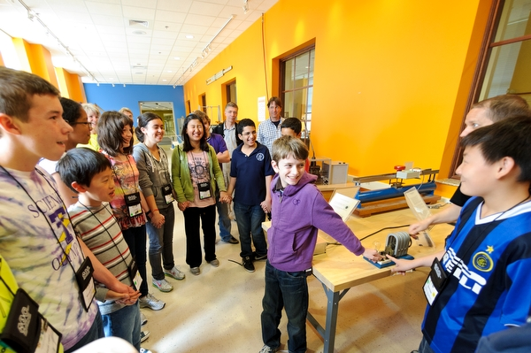
After the show…
Visit the Wonders of Physics information table and purchase a T-shirt for $12!
Visit the Ingersoll Physics Museum

Slide 19
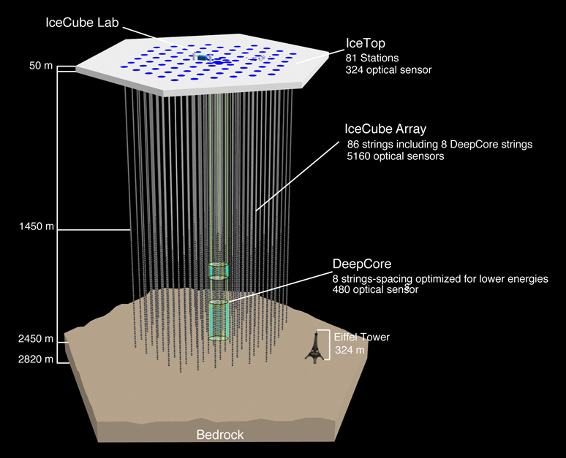
IceCube Neutrino Detector
A unique telescope at the South Pole! Most telescopes look at light; IceCube looks for mysterious particles called neutrinos.
Neutrinos come from the sun, cosmic rays, and exploding stars! Over 5,000 basketball-sized detectors were placed deep in the Antarctic ice. The detectors look for flashes of blue light given off when neutrinos hits atoms. The direction and intensity of the light can tell us where the neutrino came from in the Universe.
IceCube is the world's largest neutrino detector, encompassing a cubic kilometer of ice! Many of the detectors were built and tested at UW-Madison.
Visit http://www.icecube.wisc.edu/ for more information.

Slide 20

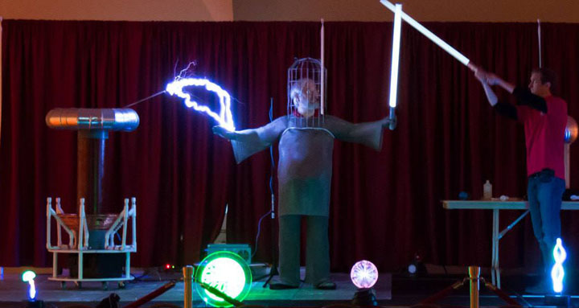
Don’t miss
Science Expeditions 2015!
March 20 - 22, 2015
UW-Madison campus
Fun, family-friendly event for kids and adults of all ages
FREE!
Saturday only: Performances of
“The Physics of Plasma”, Chamberlin Hall
Visit science.wisc.edu for schedule and more.

Slide 21


Funding Support
The Wonders of Physics program is made possible by grants from the Office of Fusion Energy Sciences of the United States Department of Energy and the National Science Foundation…

Slide 22
Funding Support
However, this funding is ending.

Slide 23
Funding Support
We need your help!

Slide 24

Funding Support
Please visit http://wonders.physics.wisc.edu/362.htm
to find out how you can make a difference!
Thank you!

