Slide 1
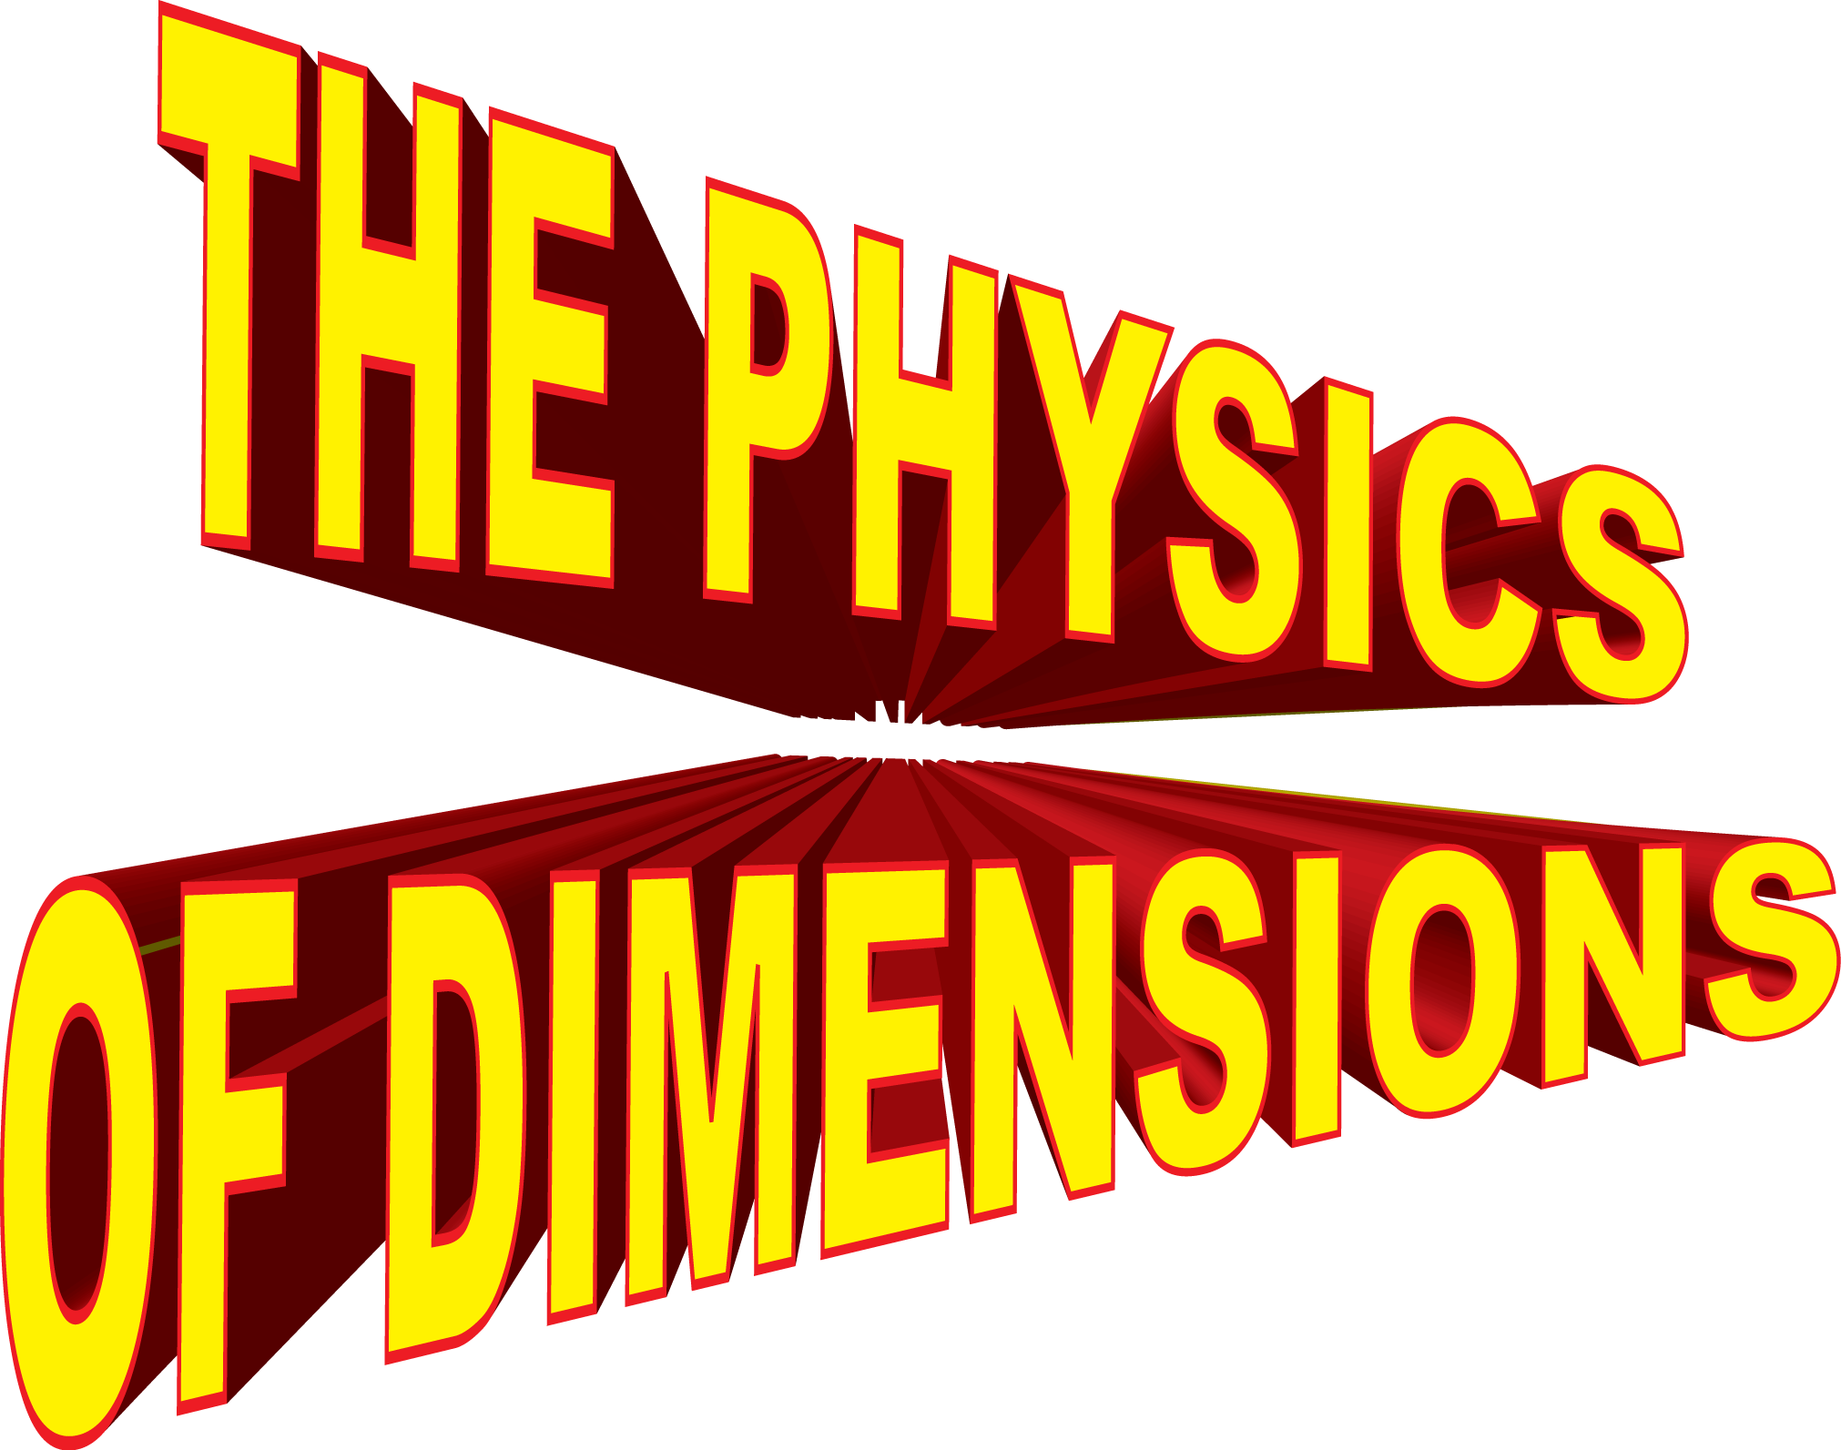
Welcome to The Wonders of Physics 2014!

Slide 2
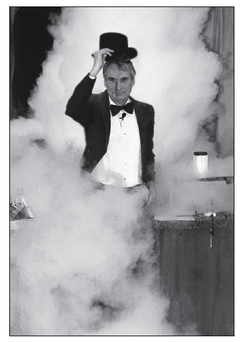
The 31st year of The Wonders of Physics!
The first presentation of The Wonders of Physics was in 1984.
The shows were inspired by UW Chemistry Professor Bassam Shakhashiri’s “Once Upon a Christmas Cheery” lectures.
Through 2013, Professor Sprott and friends have presented 257 shows to over 90,000 people!

Slide 4
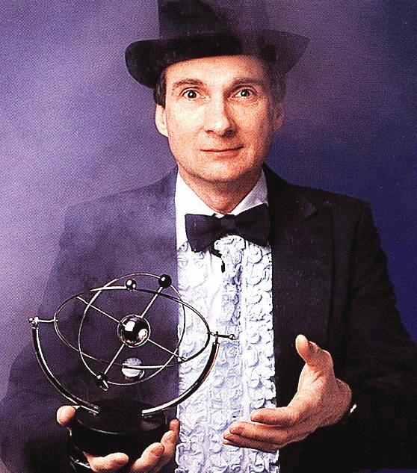
Professor Clint Sprott
Since 1984, Professor Sprott has presented The Wonders of Physics.
He became a Professor of Physics at UW-Madison in 1973.
His research is in plasma physics and chaos.

Slide 5
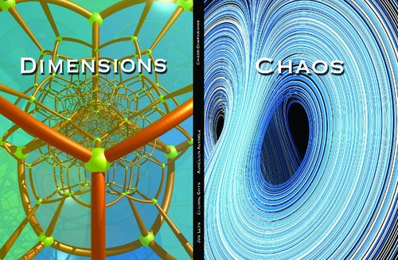

Slide 6
Don’t miss the Physics Fair!
Hands-on activities and lab tours
Meet scientists and students
Free and open to the public. No tickets required.
http://wonders.physics.wisc.edu/physics-fair.htm

Slide 7
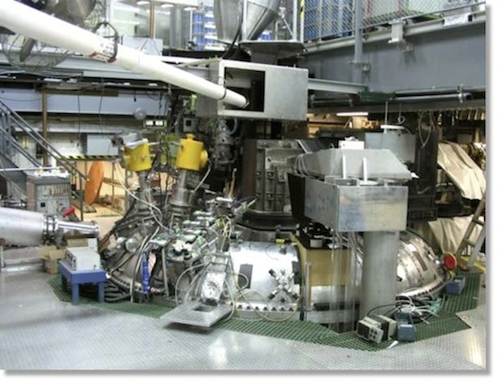
Madison Symmetric Torus
The Madison Symmetric Torus (MST) produces hot plasma for research in plasma physics and fusion power generation, the energy source of the sun.
Plasma is created when five giant capacitor banks dump 20 million watts of power in 1/10th of a second! That’s enough juice to light up a small town (very briefly).
Every time the MST fires, it makes a loud 'WOMP', scaring the bejeezus out of unsuspecting students as they walk by!
The MST is located right here in Chamberlin Hall.
Visit http://plasma.physics.wisc.edu for more information.

Slide 8
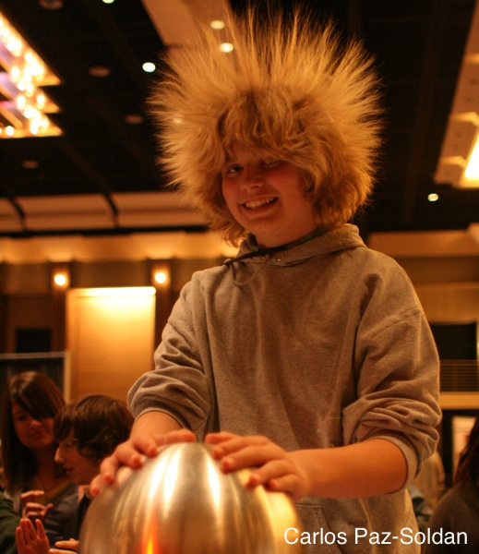
The Wonders of Physics Traveling Show can visit your school!
Over 1000 traveling shows have been presented to 100,000+ students in all 76 Wisconsin counties, 31 other states, and 5 foreign countries.
The Wonders of Physics shows make a great science assembly program for school groups of all grade levels.
For more information, see wonders.physics.wisc.edu

Slide 9
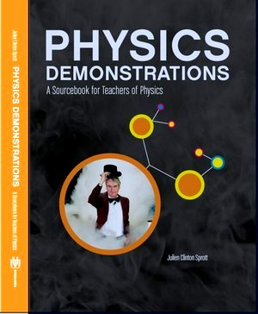
Physics Demonstrations: A Sourcebook for Teachers of Physics
Professor Clint Sprott’s book is a great resource for any science teacher.
It contains detailed descriptions of 85 physics demonstrations used in The Wonders of Physics.
It is accompanied by two DVDs showing all 85 demonstrations presented to a live audience.
It is available on Amazon.com

Slide 10
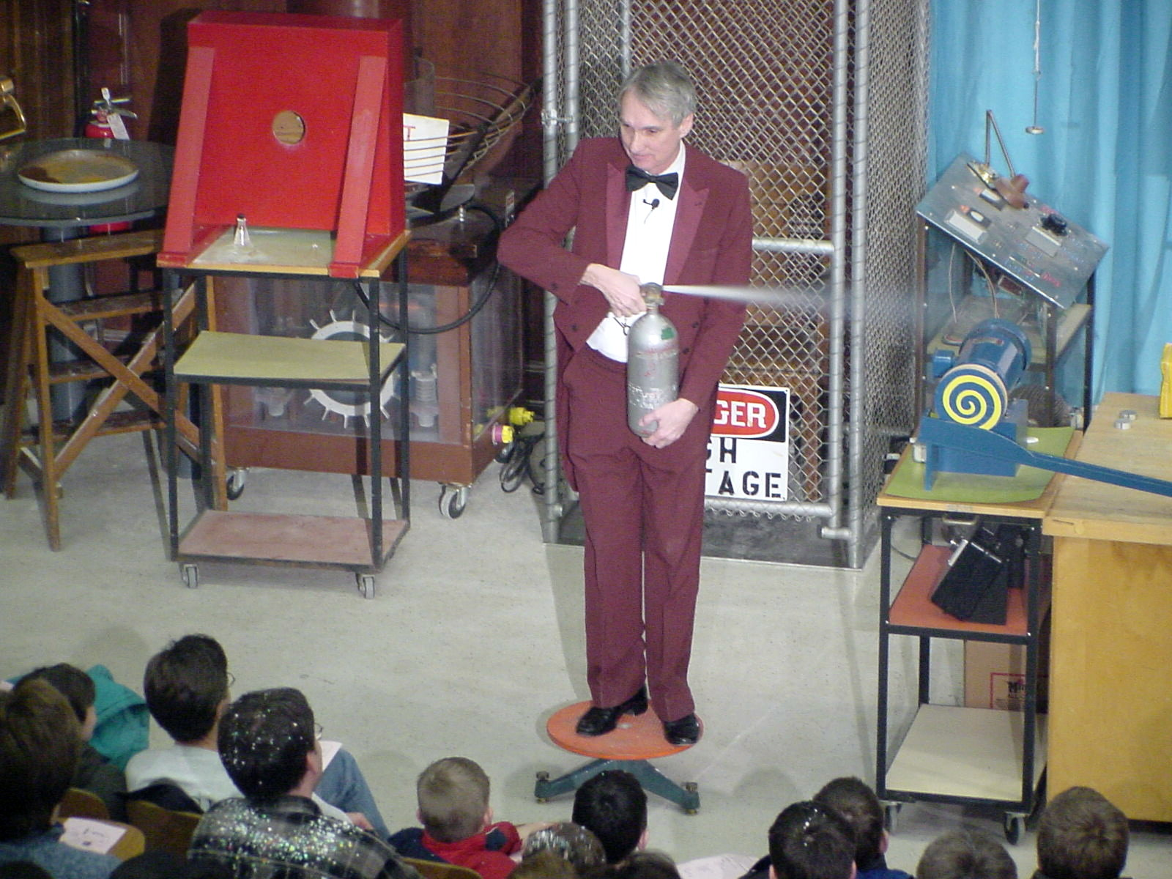
The Wonders of Physics shows are available on DVD and online!
Order any of the past 30 years of shows on DVD, or order the whole set!
Watch all of the past shows online.
Google “Wonders of Physics DVD” for more information.
DVDs are available at The Wonders of Physics information table.

Slide 11
Images of a Complex World
By Robin Chapman and J.C. Sprott
Contains fractal art, poetry, and scientific explanations
Available on Amazon.com

Slide 12
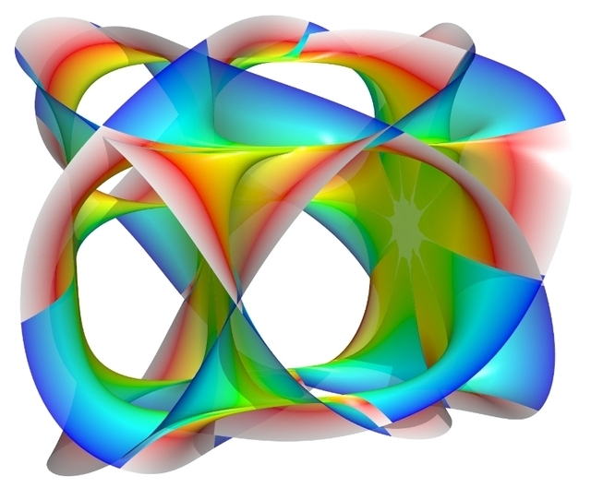

Slide 13
Don’t miss Science Expeditions 2014!
Saturday, April 5th, 2014, UW-Madison campus
Over 50 exploration stations with hands-on activities
Science Spectaculars
The Wonders of Physics
Fusion Science Theater
Chemistry Demo Show
Visit science.wisc.edu for schedule and more.

Slide 14
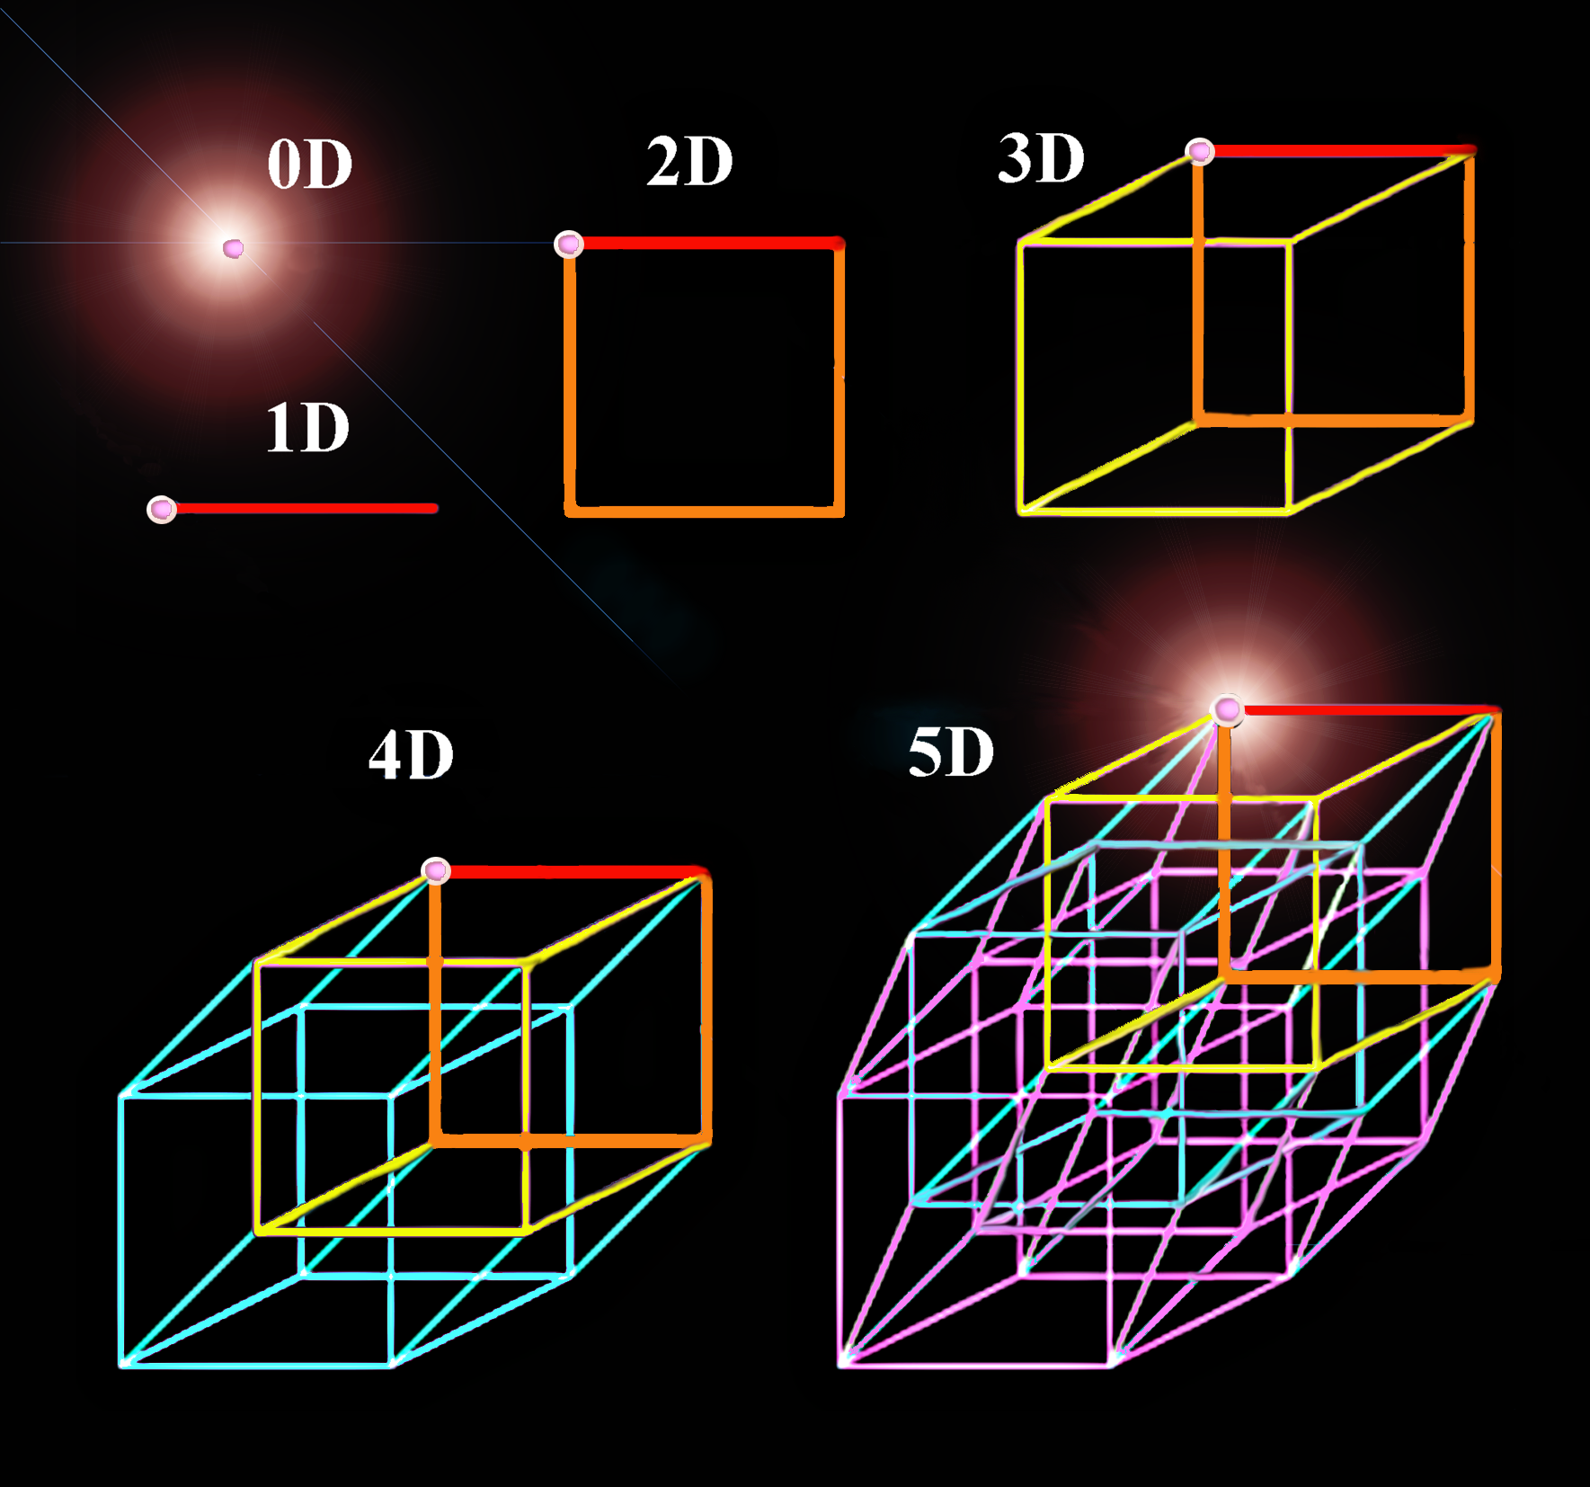

Slide 15
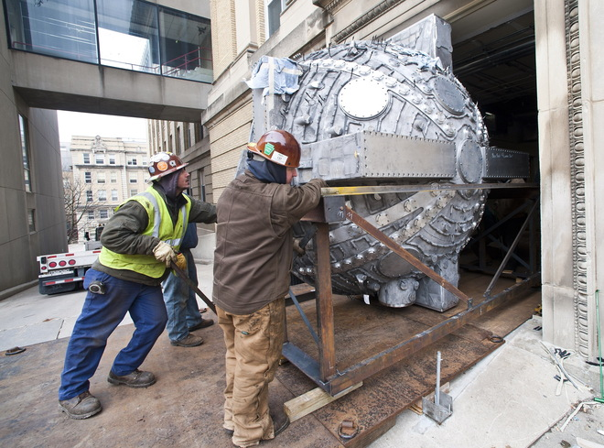
Madison Plasma Dynamo Experiment
A new UW-Madison research project to simulate the superheated gases that form the sun's magnetic field.
The hollow aluminum sphere, built by four Wisconsin companies, weighs 11,000 pounds. It was built to heat gases to 500,000 degrees Fahrenheit.
It will help researchers understand why the sun occasionally spews out particles that affect the Earth, knocking out satellites and even taking down power grids!
The sphere now occupies a new two-story lab in Sterling Hall.
Visit http://plasma.physics.wisc.edu for more information.

Slide 16
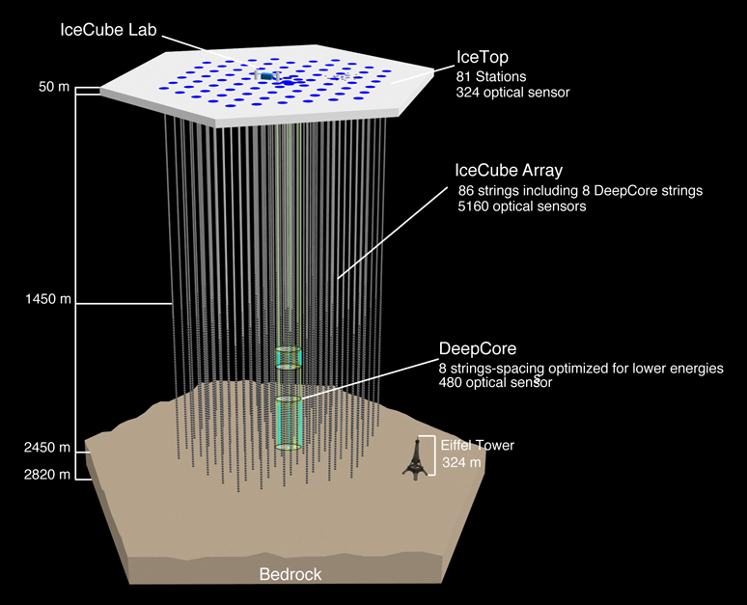
IceCube Neutrino Detector
A unique telescope at the South Pole! Most telescopes look at light; IceCube looks for mysterious particles called neutrinos.
Neutrinos come from the sun, cosmic rays, and exploding stars! Over 5,000 basketball-sized detectors were placed deep in the Antarctic ice. The detectors look for flashes of blue light given off when neutrinos hits atoms. The direction and intensity of the light can tell us where the neutrino came from in the Universe.
IceCube is the world's largest neutrino detector, encompassing a cubic kilometer of ice! Many of the detectors were built and tested at UW-Madison.
Visit http://www.icecube.wisc.edu/ for more information.

Slide 17
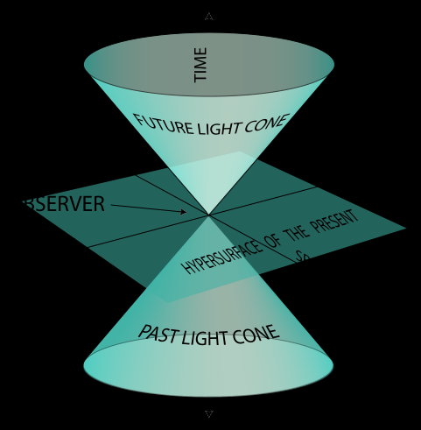

Slide 18
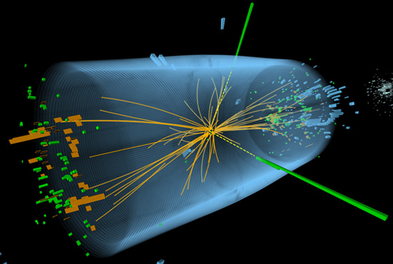
Discovery of the Higgs Boson
Physicists from The University of Wisconsin were closely involved with the discovery of the Higgs Boson, for which the 2013 Nobel Prize in Physics was given.
The Higgs boson is thought to be responsible for imparting mass to matter

Slide 19
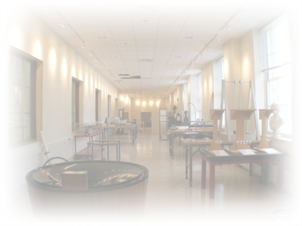
After the show…
Visit the The Wonders of Physics information table and purchase a T-shirt for $10!
Visit the Ingersoll Physics Museum

Slide 20
Donations are welcome!
Donations help us continue to present The Wonders of Physics year after year!
Donation bins are located outside of the lecture room.
Donate online! Visit wonders.physics.wisc.edu and click the Donate tab.

Slide 21
Funding Support
The Wonders of Physics program is made possible by grants from the Office of Fusion Energy Sciences of the United States Department of Energy, the National Science Foundation, and your generous contributions!
Thank you!

