Slide 1
Energy and Ecosystems
Howard T. Odum’s
“Energy, Ecology, and Economics” (1974)
for Today’s World
Chaos and Complex Systems Seminar
10 February 2015
H. William Fischer, M.D., J.D.
Phone: 314.780.0001
fischer.hw@gmail.com

Slide 2
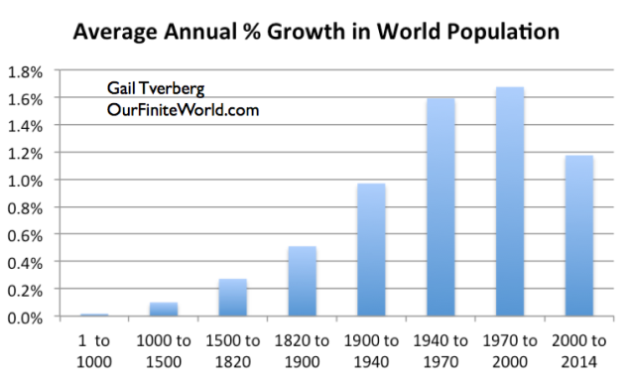

Slide 3
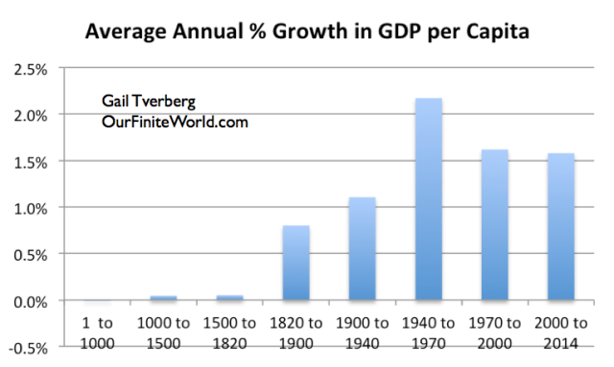

Slide 4
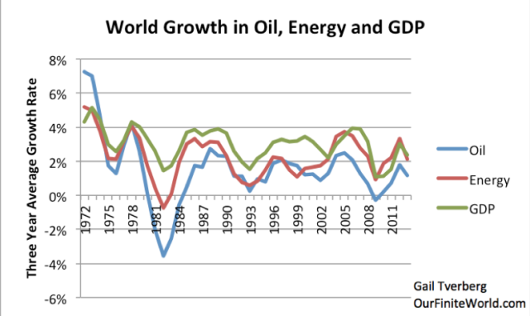

Slide 5
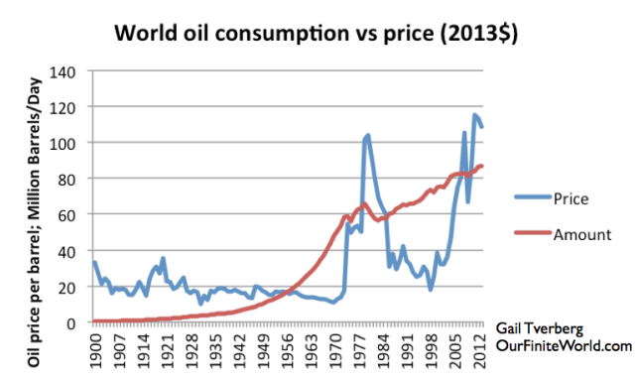

Slide 6
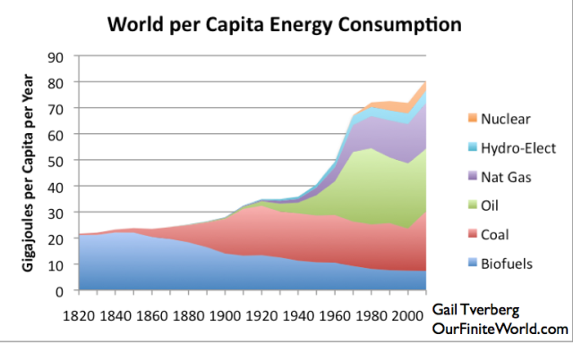

Slide 7
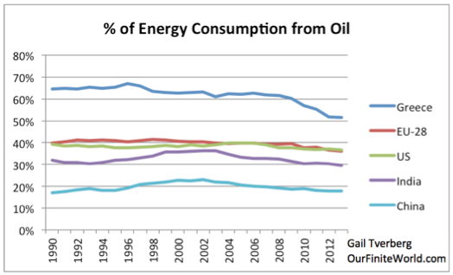

Slide 8
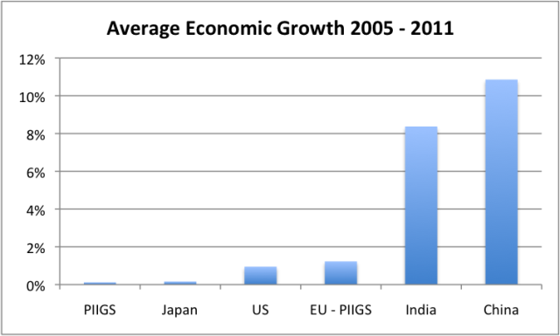

Slide 9
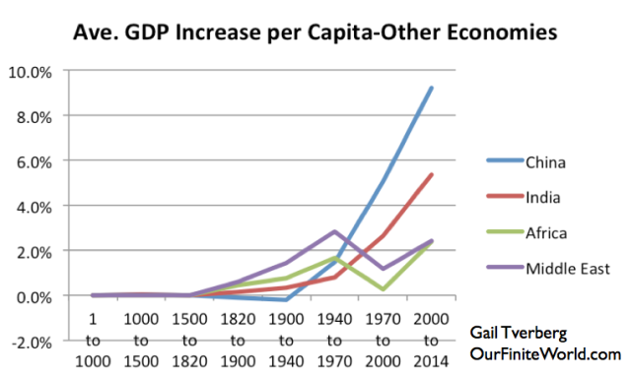

Slide 10
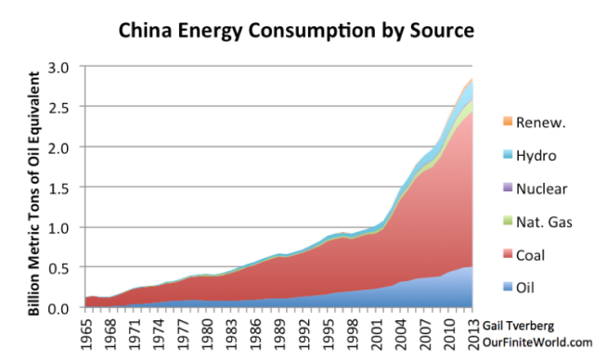

Slide 11
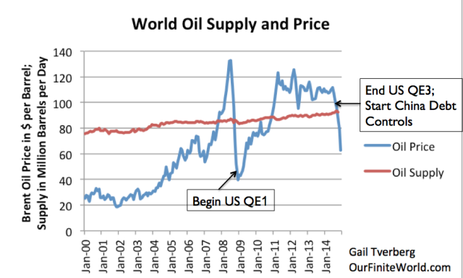

Slide 12
A Maximum Affordable Oil Price?
There seems to be a maximum price that the world economy can pay. $120/barrel seems to lead to economic decline in the U.S. and Europe and continuing growth in economies like China (which use a lot of oil), and India (which uses more oil but has lower average wages).

Slide 13
ENERGY COST AND VALUE
Economic cost and value have traditionally been analyzed in terms of labor and capital (originally land, later all material means of production). Insofar as energy had a cost, it was measured in terms of the capital and labor costs of obtaining it.
Macroeconomics hasn’t predicted very well. Nor has it explained productivity or growth. Energy is the predominant factor in productivity and GDP, but macroeconomics hardly considers it.
Economic production has correlated with energy use throughout history.
Energy use and human culture co-evolved, with development of each enabling development of the other.

Slide 14
GROWTH
Human population and its economy grew only slowly until the 19th century.
For most of human history, technological advances were in physical tools and processes (including fire, weapons, domesticated plants and animals, wheels, and sailing vessels)
Changes in social organization coevolved to allow growth by better harvesting what solar energy produced, either directly in hunting and agriculture, or indirectly, from wind and water.
Growth took off in the nineteenth century, when the tools to mine and use coal developed rapidly.
Growth further accelerated in the twentieth century and the age of oil.

Slide 15
SLOWED GROWTH: THE CURRENT QUANDARY
Growth has slowed in the past 40 years. In recent years, per capita economic growth may have stopped or be negative
In the U.S., average wages have not increased for many years.
Only the wealthy have more, but that may not reflect increased production. Note different causes: decreased taxation, increased subsidies, government spending, QE, TARP. How much wealth is artifact, or artifice?

Slide 16
Liebig’s Law
Summary: the availability of the most abundant nutrient in the soil is only as good as the availability of the least abundant nutrient in the soil.
For most of human history, energy was the least abundant nutrient in the human economy
During the nineteenth and twentieth century, other nutrients limited growth.
Are we returning to energy limits?

Slide 17
ENERGY ACCOUNTING
For most of human history, fossil fuel energy was unavailable. For two centuries, fossil fuels were so available that their cost (either in money or in terms of difficulty of obtaining them) was insignificant compared to capital and labor costs. Now, energy costs are again substantial. Inadequate energy cost accounting may explain current limitations of economic theories.

Slide 18
ENERGY PRICE IS INADEQUATE FOR ACCOUNTING ITS TRUE COST (OR VALUE)
The price of energy is unpredictable and generally underestimates its true cost, because
energy cost has a multiplier effect increasing the cost of everything else (capital, labor, other resources) used in the economy;
international affairs, economic uncertainty, and government policy unpredictably affect price;
energy cost tends to be accounted for in terms of current prices, which besides being affected by the above extraneous factors do not yet reflect the multiplier inflationary effect of real current costs;
replacement costs are not considered at all, because:
1. the economic system demands current price accounting,
2. no replacement cost estimate can be valid - the best energy
sources were used first: costs increase with time,
but unpredictably.

Slide 19
Energy, Ecology, and Economics
True Value
1. The true value of energy to society is the net energy, which is what's left after the energy costs of getting and concentrating that energy are subtracted.
[All economic value reflects energy value. Nothing is produced without energy. Valued objects have embodied energy.]

Slide 20
Energy Returned on Energy Invested (EROI)
Perhaps the most important ecological energetics accounting concept is net energy, or Energy Returned on Energy Invested (EROI). Historically, economic growth has required growth of total net energy.
The increasing energy cost of energy production explains much of the current economic quandary, although many uncertainties remain and complicate energy cost accounting methods.

Slide 21
EROI (Energy returned on energy invested)=Energy Out/Energy In
Modern civilization has flourished on very high EROIs
The higher the EROI, the more surplus energy.
Surplus energy enables growth.
When EROI is high, other inputs (capital, labor, money, debt) furnish Liebig’s limits.
Economics has developed in an era of cheap energy, when its cost was not limiting.
Energy is now creating limits, but we don’t know the interactions between EROI and traditional input limitations.

Slide 22
EROI’s of fossil fuels have been so high as to be irrelevant. That’s not so now. [The later estimates especially may be too high because they don’t include enough indirect energy costs (embodied energy).]
EROIs:
Oil (1930s) 100
Coal (2005) 80
Hydroelectric 30
Oil (1970) 30
Wind 18
Oil (2000, domestic) 15
Solar 7
Ethanol 1

Slide 23
Problems in estimating EROI
Measuring the total energy content of output is straightforward, but outputs (electricity, natural gas, oil, and coal) have varying qualities.
Energy inputs may be direct (fuel used in production) or indirect (all the energy ultimately required by the production system)
The more indirect use is included as an input, the lower the estimated EROI.
In the conceptual limit, EROI=1. All energy that a society used might be seen as ultimately going to producing more energy.

Slide 24
y=Energy invested/Energy out=1/EROI x=EROI (Energy out/Energy invested)
[The amount needed to get a given amount out increases asymptotically as EROI approaches zero.]

Slide 25
y=net energy/energy out=1-(1/EROI) x=EROI
[The proportion of energy out that is net energy decreases faster the more the EROI decreases, that is the proportion of useful energy decreases faster and faster as we go to less and less productive sources.]

Slide 26
y=Energy In Needed/Net Energy Produced=1/(EROI-1) x=EROI
[As EROI approaches 1, the energy needed to produce a given amount of energy increases asymptotically.]

Slide 27
Ethanol Example
The threshold usefulness of EROI: if the EROI isn’t greater than 1, there’s no net energy yield, which creates a presumption that it shouldn’t be done at all.
Ethanol is a good example: The energy produced from using it as a fuel is less than the energy needed to produce it.
That ethanol production does not yield net energy indicates that it would not be produced in significant if it were not subsidized.
Ethanol production does, however, use large amounts of natural gas, which is relatively abundant and unsuitable for vehicles, and produces vehicular fuel.
Ethanol production may, however, indirectly consumes more fuel, perhaps even more vehicular fuel, than it produces. Corn production requires energy to make and maintain its inputs: machinery, fertilizer, transport, capital and laborers. The long-term cost of compensating for soil erosion might also be included. So also might the creation of higher prices for most foods for most people in the world.
Ultimately, ethanol production must be explained as the result of political influence and an illusion of “energy independence”.

Slide 28
“Renewable” fuels
CAPITAL INTENSIVE: Solar and wind are very capital intensive. The total EROI is only obtained over the 20+ years presumed life of the equipment.
HIGH TECH: They require sophisticated technology and long supply chains.
STORAGE AND TRANSMISSION: They produce electricity, which is of high quality, but it also requires capital intensive transmission and unless supplemented prohibitively capital expensive storage.

Slide 29
Cost and Value Reflect Energy
In the limit, goods and services cost what it costs in energy to produce them.
Are goods and service ultimately worth their value in producing more energy?
Is there an energy cost/value equilibrium?

Slide 30
Inflation, Contraction, Volatility
2. Worldwide inflation [or, alternately, economic contraction] is driven in part by the increasing fraction of our fossil fuels that have to be used in getting more fossil and other fuels.
[Odum did not address the power of oil price inflation to contract economies. Instead of inflation we have cycles of oil price inflation, economic contraction, oil price deflation, economic expansion. In fact, 10 of the last 11 recessions seem to have been triggered by oil price rises: seeHamilton, Causes and Consequences of the Oil Shock of 2007–08 (Brookings Papers on Economic Activity, Spring 2009) . ]

Slide 31
Energy Reserves
3. Many calculations of energy reserves which are supposed to offer years of supply are as gross energy rather than net energy and thus may be of much shorter duration than often stated.
[We don’t know, e.g., what the net energy of fracked oil is. We do know that costs are high and production on individual wells declines rapidly.]

Slide 32
Lotka’s Maximum Power Principle
4. Societies compete for economic survival by Lotka's principle, which says that systems win and dominate that maximize their useful total power from all sources and flexibly distribute this power toward needs affecting survival.

Slide 33
Pioneer vs Mature (Steady-State) Ecosystems
5. During times when there are opportunities to expand one's power inflows, the survival premium by Lotka's principle is on rapid growth even though there may be waste.
6. During times when energy flows have been tapped and there are no new sources, Lotka's principle requires that those systems win that do not attempt fruitless growth but instead use all available energies in long-staying, high-diversity, steady-state works.

Slide 34
Mature Ecosystems Are Equitable and Cooperative
7. High quality of life for humans and equitable economic distribution are more closely approximated in steady-state than in growth periods.
8. The successfully competing economy must use its net output of richer-quality energy flows to subsidize the poorer-quality energy flow so that the total power is maximized.

Slide 35
Hidden Subsidies
9. Energy sources which are now marginal, being supported by hidden subsidies based on fossil fuel, become less economic when the hidden subsidy is removed.
10. Increasing energy efficiency with new technology is not an energy solution, since most technological innovations are really diversions of cheap energy into hidden subsidies in the form of fancy, energy-expensive structures.
15. Nuclear energy is now mainly subsidized with fossil fuels and barely yields net energy.
[One doesn’t know if so-called “sustainable” energy sources can produce enough of the right kind of energy to sustain civilization.]

Slide 36
Ecosystem Services
11. Even in urban areas more than half of the useful work on which our society is based comes from the natural flows of sun, wind, waters, waves, etc., that act through the broad areas of seas and landscapes without money payment. An economy, to compete and survive, must maximize its use of these energies, not destroying their enormous free subsidies. The necessity of environmental inputs is often not realized until they are displaced.
12. Environmental technology which duplicates the work available from the ecological sector is an economic handicap.

Slide 37
Evolutionary Maxima
13. Solar energy is very dilute and the inherent energy cost of concentrating solar energy into form for human use has already been maximized by forests and food-producing plants. Without energy subsidy there is no yield from the sun possible beyond the familiar yields from forestry and agriculture.

Slide 38
Quantity and Quality
14. Energy is measured by calories, Btu's, kilowatt hours, and other intraconvertible units, but energy has a scale of quality which is not indicated by these measures. The ability to do work for man depends on the energy quality and quantity, and this is measurable by the amount of energy of a lower-quality grade required to develop the higher grade. The scale of energy goes from dilute sunlight up to plant matter to coal, from coal to oil to electricity and up to the high-quality efforts of computer and human information processing.
[This is where the accounting really becomes difficult. We may know something of the high-quality energy cost, e.g., of information, but very little about how to compare its values.]

Slide 39
Energy Storage
16. Substantial energy storages are required for stability of an economy against fluctuations of economies, or of natural causes, and of military threats.
[Odum focuses on mid- and long-term storage, which are important for resilience and resistance to collapse. But short-term storage, which solar and wind energy require, is also very important, and for now prohibitively expensive.]

Slide 40
Energy and the Balance of Trade
17. The total tendency for net favorable balance of payments of a country relative to others depends on the relative net energy of that country including its natural and fuel-based energies minus its wastes and nonproductive energy uses.
[China has done well economically because it runs mostly on coal.]

Slide 41
Cheap and Expensive Energy Require Different Policies
18. During periods of expanding energy availabilities, many kinds of growth-priming activities may favor economic vitality and the economy's ability to compete. Institutions, customs, and economic policies aid by accelerating energy consumption in an autocatalytic way.
19. During periods when expansion of energy sources is not possible, then the many high-density and growth-promoting policies and structures become an energy liability because their high energy cost is no longer accelerating energy yield.
[Autocatalysis in an era of expensive energy dissipates energy that is needed for transitions and thereby accelerates decline.]

Slide 42
Transition or Collapse?
20. Systems in nature are known that shift from fast growth to steady state gradually with programmatic substitution, but other instances are known in which, the shift is marked by total crash and destruction of the growth system before the emergence of the succeeding steady-state regime.
[See 7. and 8.: Steady-state systems are equitable and cooperative. Transition, and survival, may require flexibility, cooperation (including government) and more democracy.]

