Slide 1
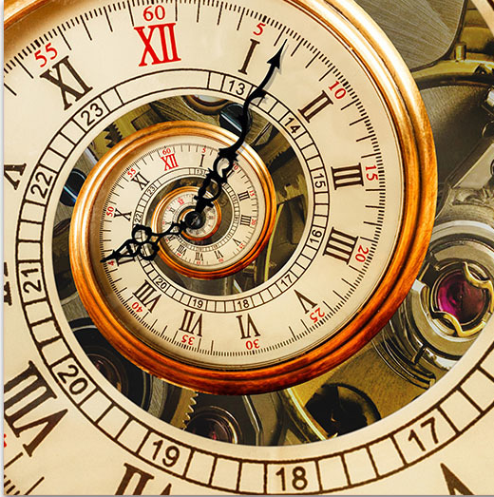
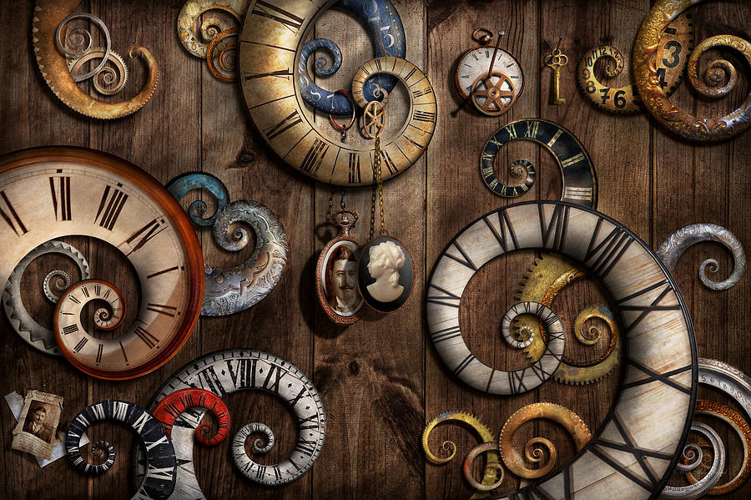
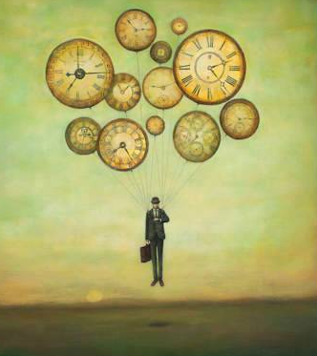
Welcome to The Wonders of Physics!
Notes:
https://fineartamerica.com/featured/steampunk-clock-time-machine-mike-savad.html
https://theculturetrip.com/europe/united-kingdom/england/london/articles/the-history-of-big-ben-in-1-minute/
https://www.directartaustralia.com.au/spiral-old-clock-wall-art-print/
https://www.icanvas.com/canvas-art-prints/tag/clocks?product=canvas&sort=popular

Slide 2
“The Physics of Time”
Notes:
https://fineartamerica.com/featured/steampunk-clock-time-machine-mike-savad.html
https://theculturetrip.com/europe/united-kingdom/england/london/articles/the-history-of-big-ben-in-1-minute/
https://www.directartaustralia.com.au/spiral-old-clock-wall-art-print/
https://www.icanvas.com/canvas-art-prints/tag/clocks?product=canvas&sort=popular

Slide 3
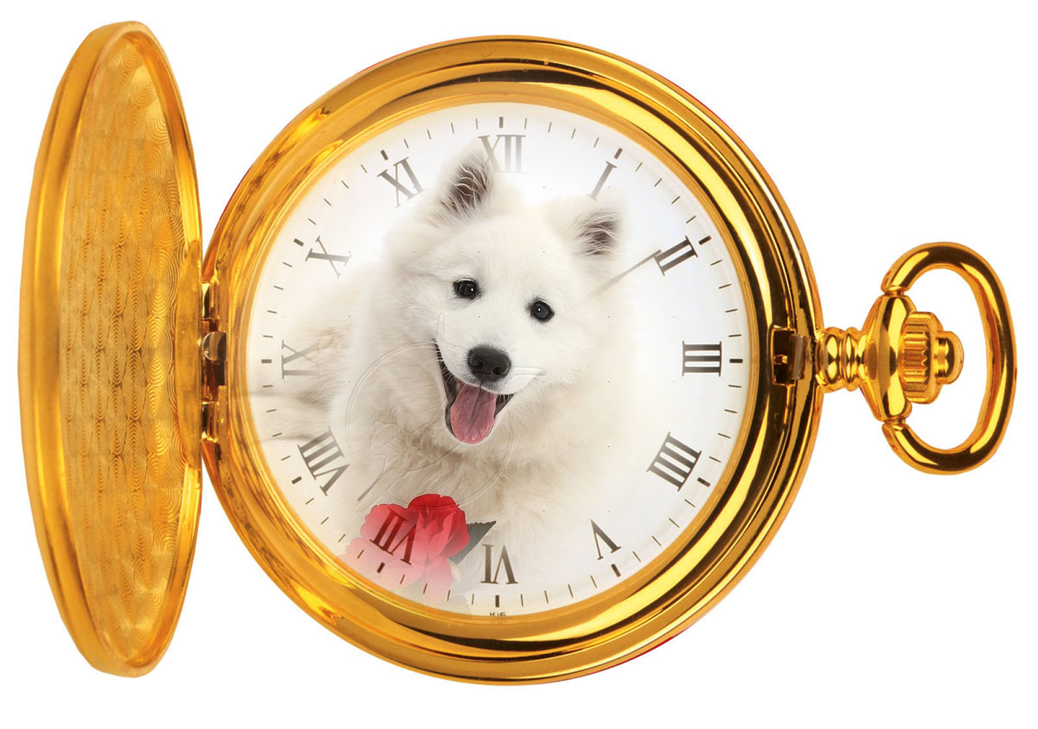
We call our dog Rolex, since he acts like a watchdog.
Notes:
https://pun.me/time-puns.php
http://sketchbookdigitalcaldwell.blogspot.com/2013/09/visual-puns.html

Slide 4
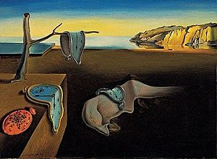
After the show…
Visit the Wonders of Physics information table and purchase a t-shirt, DVD, or science toy!
Visit the Ingersoll Physics Museum
Notes:
https://www.quora.com/What-are-some-good-puns-about-clocks
https://en.wikipedia.org/wiki/The_Persistence_of_Memory

Slide 5
11:59:59 am is my favorite time of day. It’s second to noon.
Notes:
https://punsandoneliners.com/randomness/time-jokes/
https://sapling-inc.com/products/time-zone-clocks/

Slide 6
Why did the scientist drop a wrist watch into his flask? He was looking for a timely solution.
Notes:
https://www.quora.com/What-are-some-good-puns-about-clocks
https://carrytheoneradio.com/episodes//2016/12/science-against-clock-short-talks-to.html

Slide 7
Physics Demonstrations: A sourcebook for teachers of physics
Professor Clint Sprott’s book is a great resource for any science teacher
It contains detailed descriptions of 85 physics demonstrations used in The Wonders of Physics
Videos for the demonstrations are online at: http://physicsdemonstrationsvideos.com
It is available on amazon.com for $49.95
Notes:
https://www.quora.com/What-are-some-good-puns-about-clocks
https://carrytheoneradio.com/episodes//2016/12/science-against-clock-short-talks-to.html

Slide 8
I knew someone who was habitually late, until his doctor recommended sleeping in an herb garden. Sounds odd, I know, but now he wakes up on Thyme.
Notes:
https://punsandoneliners.com/randomness/time-jokes/
https://www.etsy.com/ie/listing/683006199/aint-nobody-got-thyme-for-that-wall

Slide 9
Donations are welcome!
Donations help us continue to present The Wonders of Physics year after year!
Donation bins are located outside of the lecture room
Donate online! Visit wonders.physics.wisc.edu and click the Donate tab
Notes:
https://punsandoneliners.com/randomness/time-jokes/
https://www.etsy.com/ie/listing/683006199/aint-nobody-got-thyme-for-that-wall

Slide 10
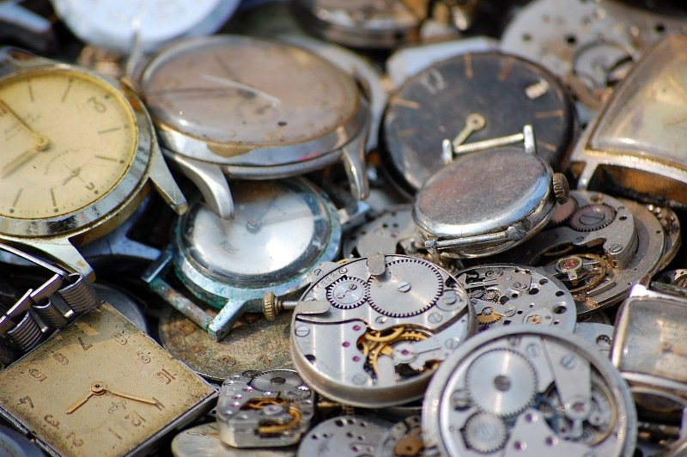
A friend of mine bought me a watch that has stopped working, but I haven’t told them yet. It’s never the right time.
Notes:
https://punsandoneliners.com/randomness/time-jokes/
https://www.4freephotos.com/Broken-watches-2470.html

Slide 11
Why did the man put a clock under his desk?
He wanted to work over time.
Notes:
https://www.thewellmadeclock.com/clock-jokes/
http://www.officeclipart.com/office_clipart_images/business_man_running_late_0521-1012-0921-2539.html

Slide 12
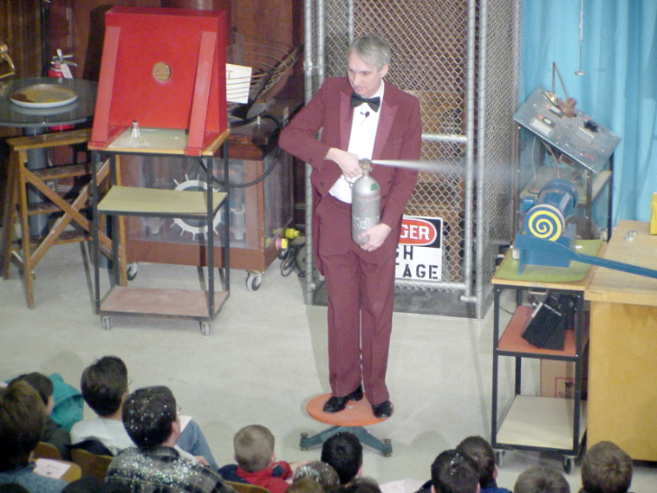
The Wonders of Physics shows are available on DVD and online!
Order any of the past 35 years of shows on DVD, or order the whole set!
Click the Gallery tab on our website to watch all of the past shows online
DVDs are available at the Wonders of Physics information table
Notes:
https://www.thewellmadeclock.com/clock-jokes/
http://www.officeclipart.com/office_clipart_images/business_man_running_late_0521-1012-0921-2539.html

