Slide 1
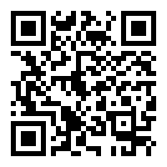
Donate:
https://wonders.physics.wisc.edu/donate/

