Slide 1
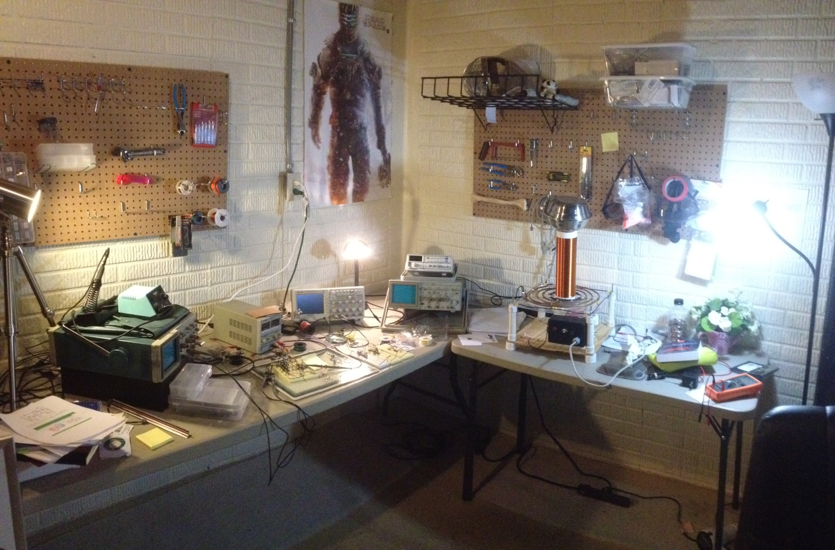
Chaos for the Home Electronics Lab
Wesley Thio

Slide 2
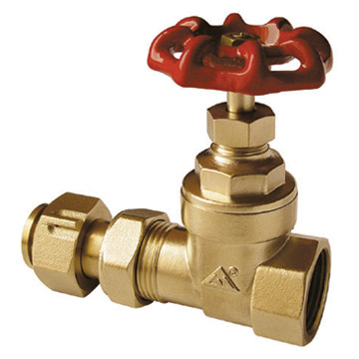
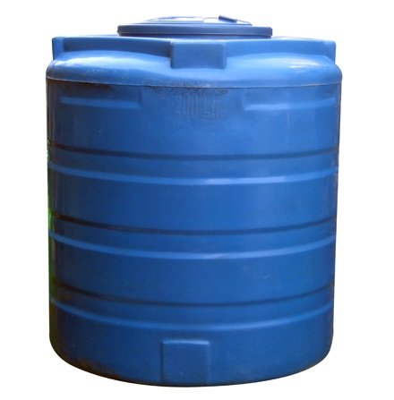
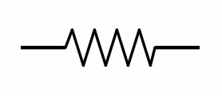
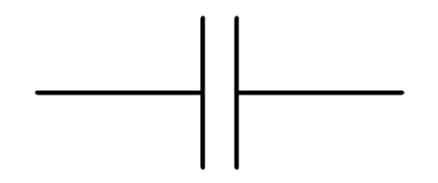
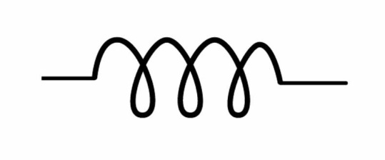
Linear Circuits

Slide 3
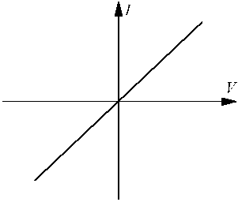
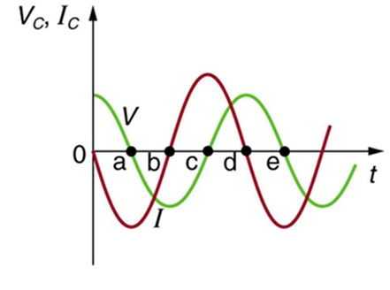
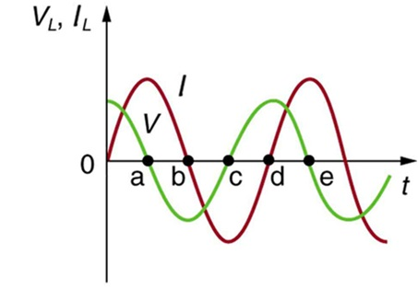
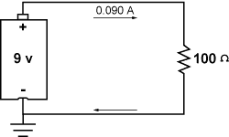
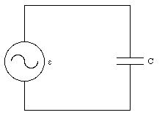
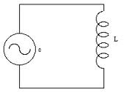
In linear circuits, voltage is proportional to the current

Slide 4
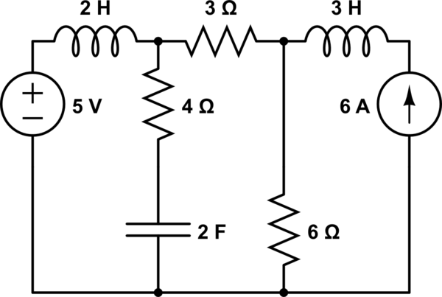
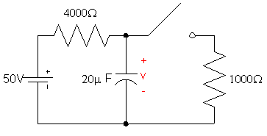
Linear circuit examples

Slide 5
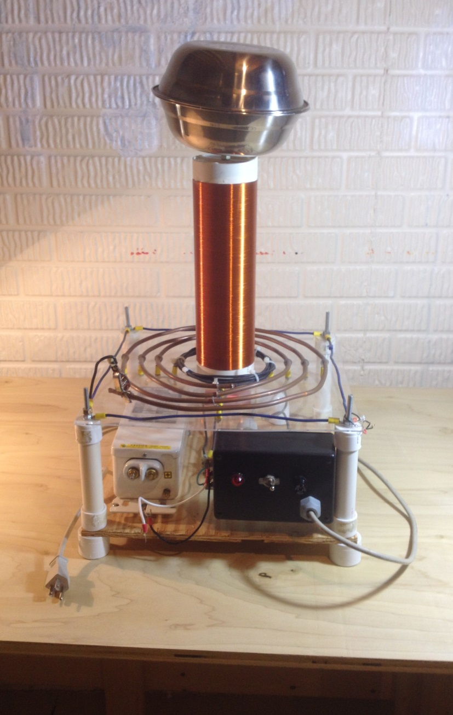
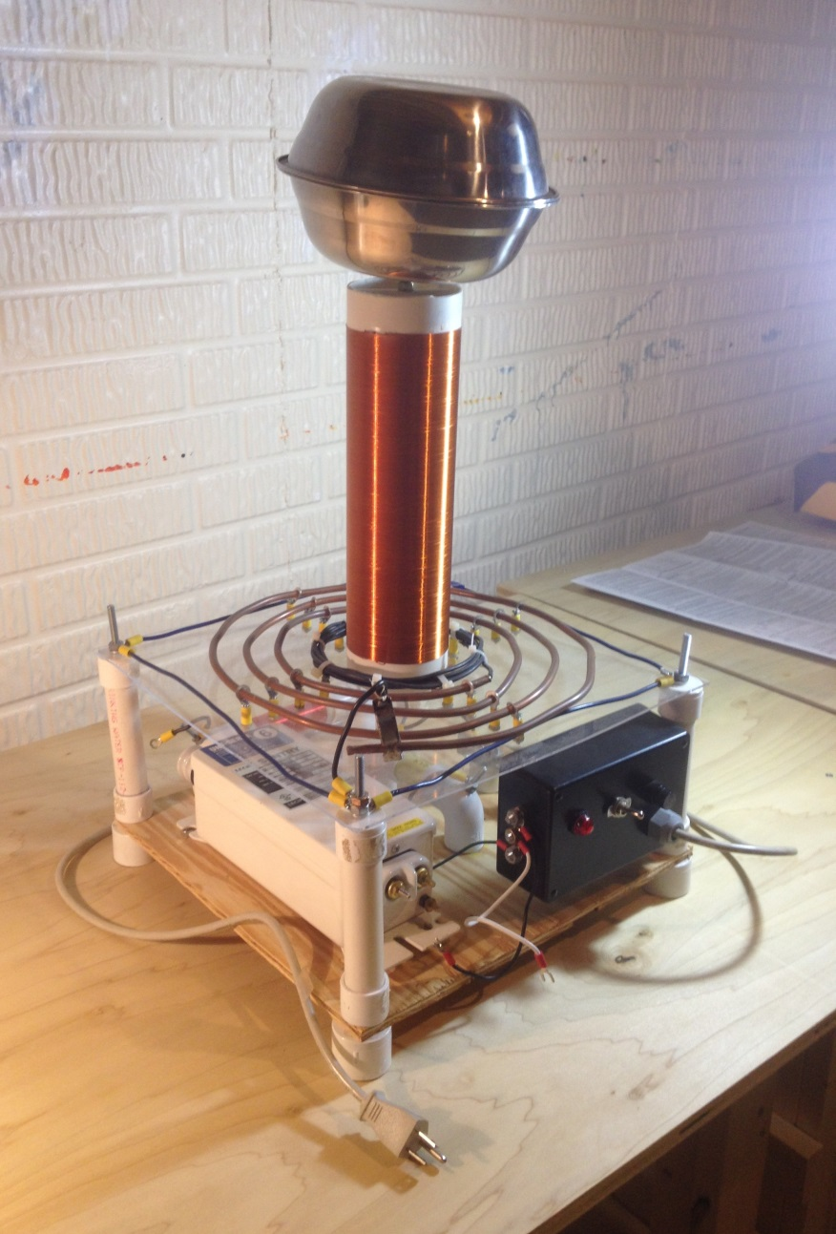
Tesla Coil

Slide 6
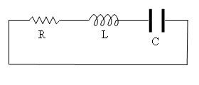
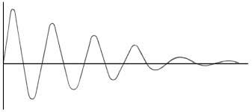
RLC circuit

Slide 7
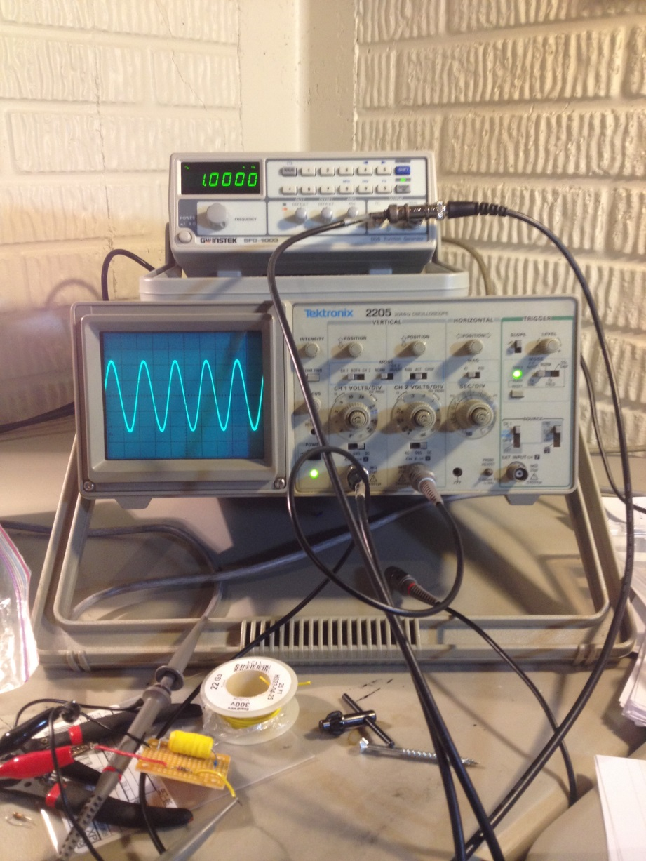
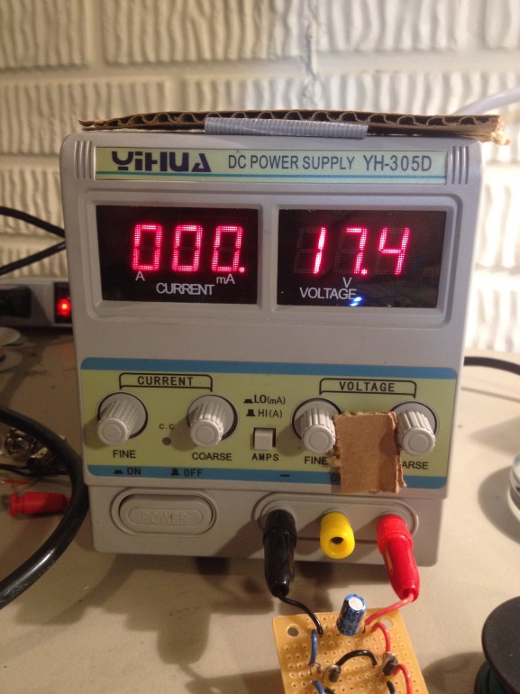
Equipment
Function Generator
Oscilloscope
Power supply

Slide 8
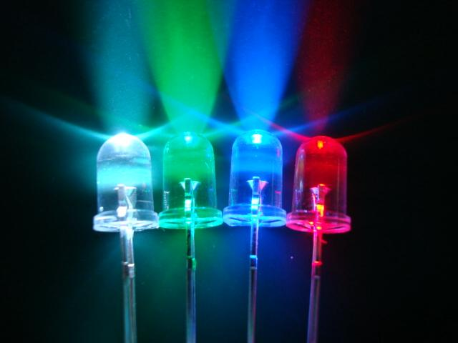
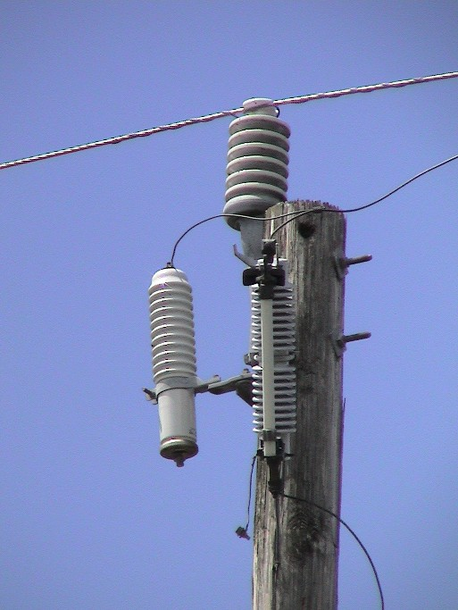
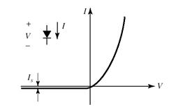
In nonlinear circuits, voltage is not proportional to current
Notes:
A bit ugly. Try to arrange it better

Slide 9
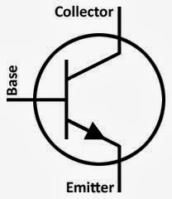
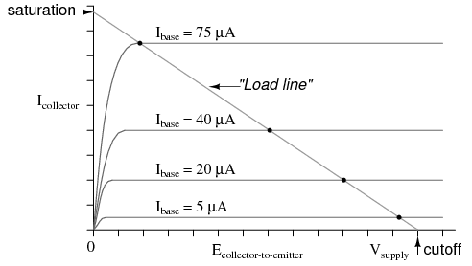
Notes:
Also arrange better

Slide 10
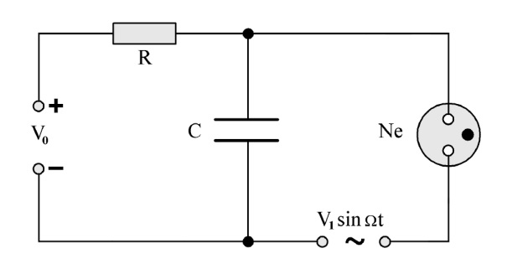
Van Der Pol Oscillator
Neon Bulb

Slide 11
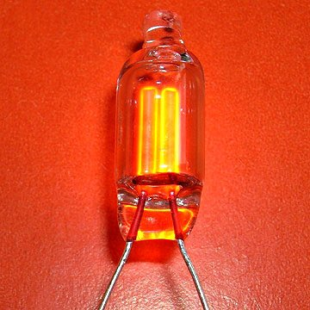
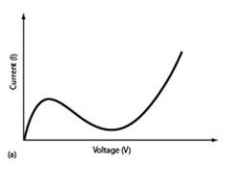
Neon Bulb nonlinearity

Slide 12
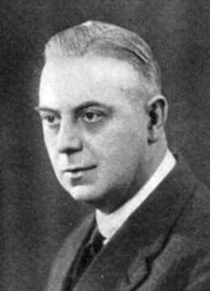
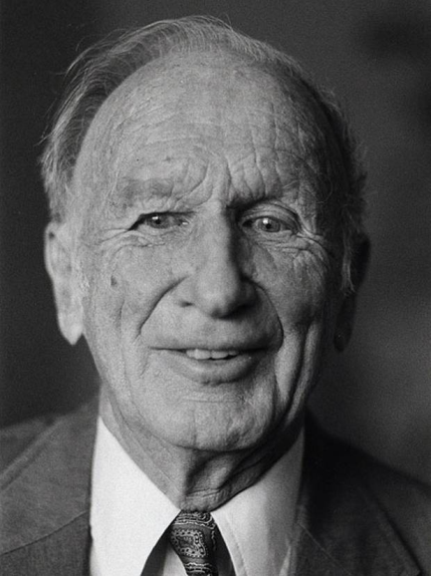
Van Der Pol
Lorenz
Chua
1927
1959
1983
Notes:
Must put in sequence

Slide 13
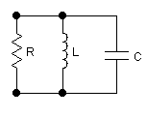
Step 1: RLC circuit (parallel)

Slide 14
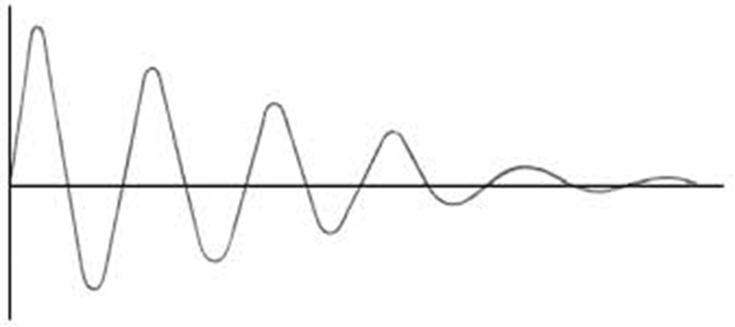
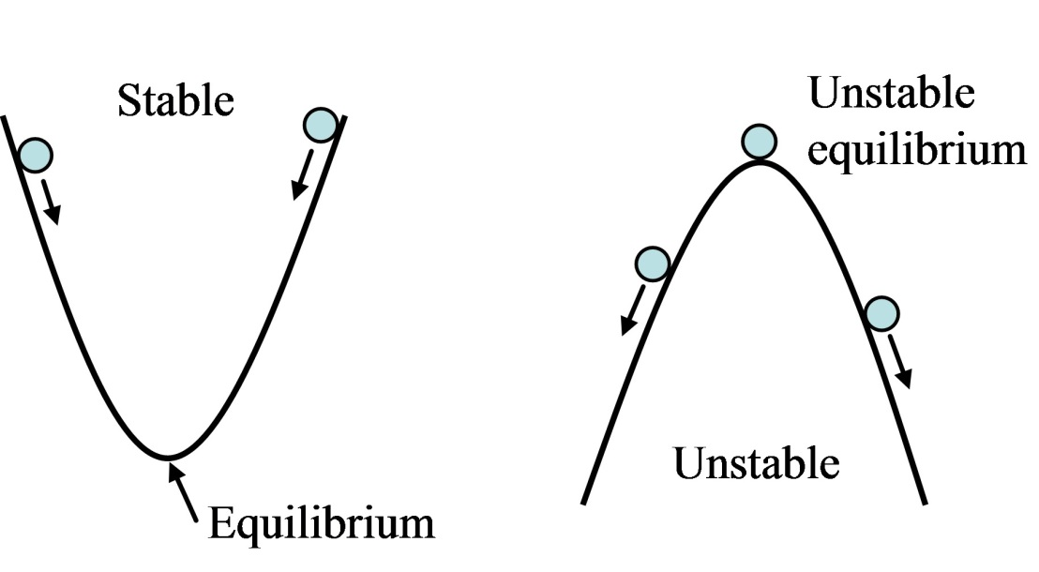
In a RLC circuit, there is one stable equilibrium point at the origin

Slide 15
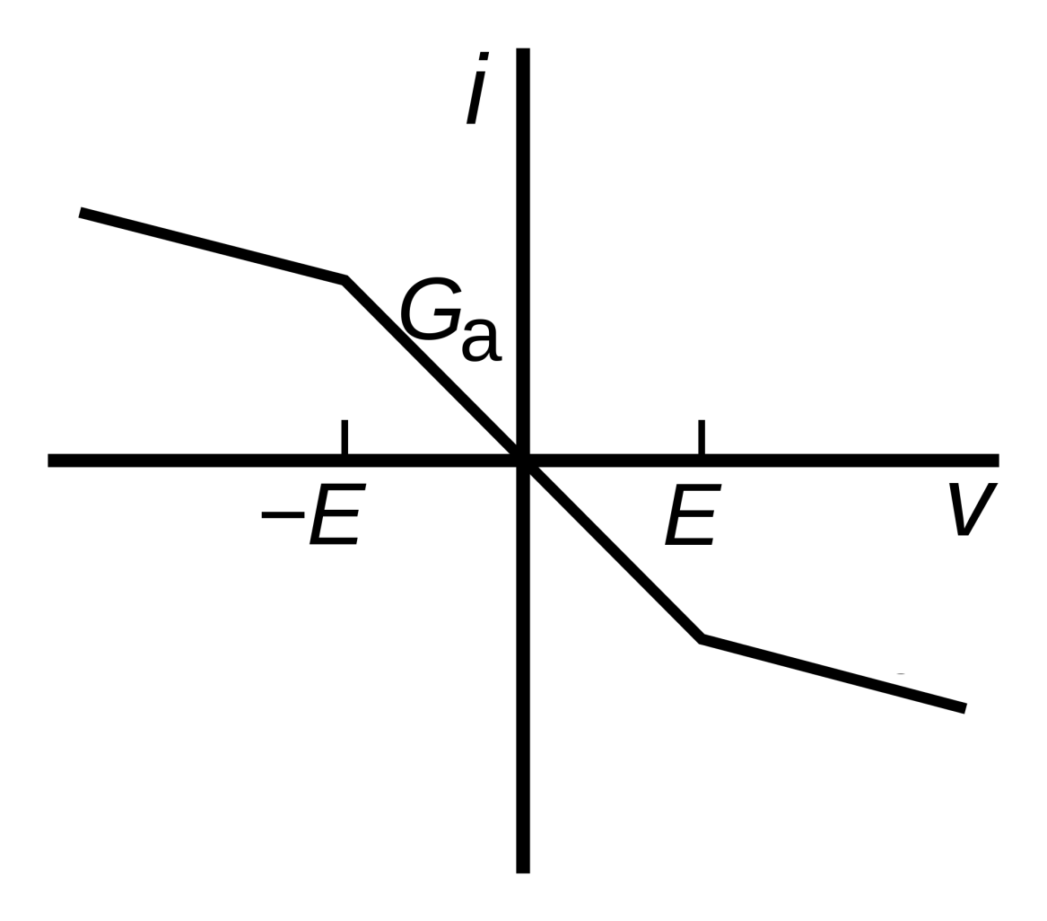
Chua’s Nonlinear resistor
3 Equilibrium points (marked red)
Notes:
Check where equilibrium points are on this graph

Slide 16
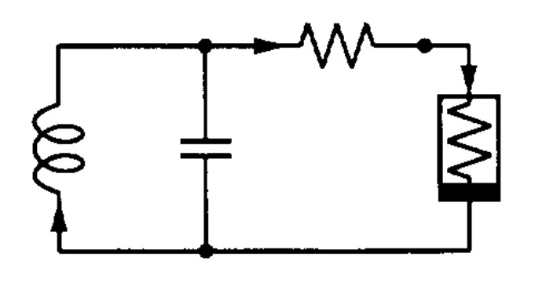
Step 2: Nonlinear Resistor
Lorenz System
Rossler System
$$\dot{x}=σ(y−x)$$
$$\dot{y}=rx−y−xz$$
$$\dot{z}=xy−bz$$
$$\dot{x}=−y−z$$
$$\dot{y}=x+ay$$
$$\dot{z}=a+z(x−c)$$

Slide 17
Step 3: Add a third capacitor or inductor

Slide 18
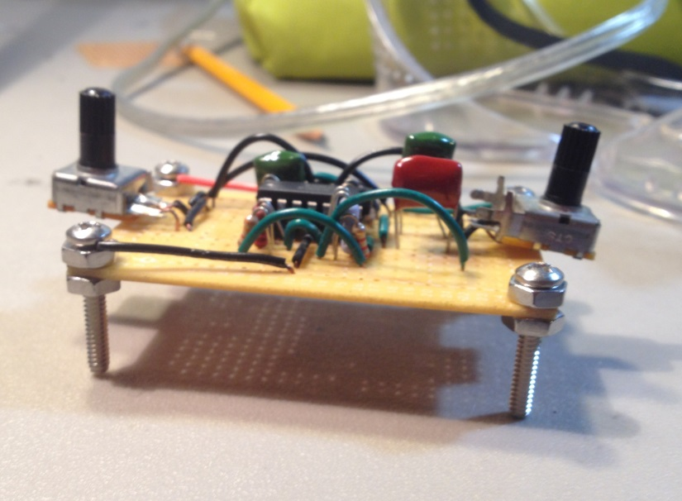
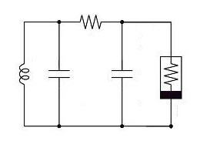
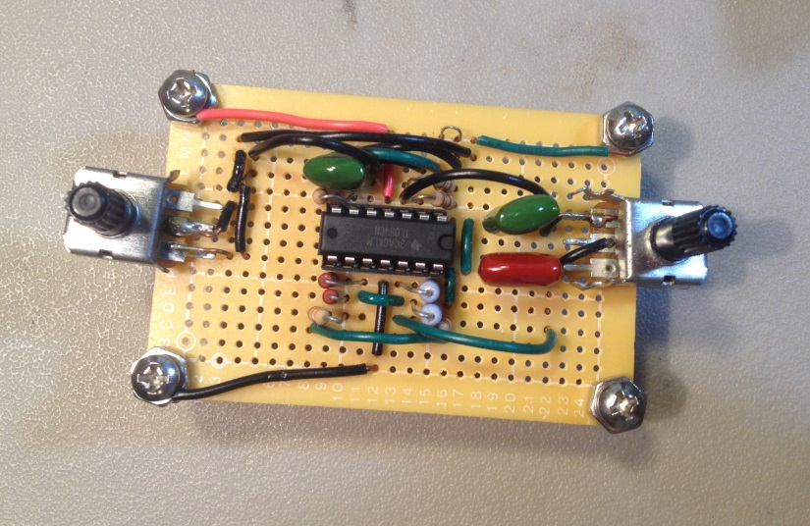
Chua’s Circuit

Slide 19
Phase Space: Take the voltage across the capacitors…
Voltage across capacitor 1
time
Voltage across capacitor 2
time

Slide 20
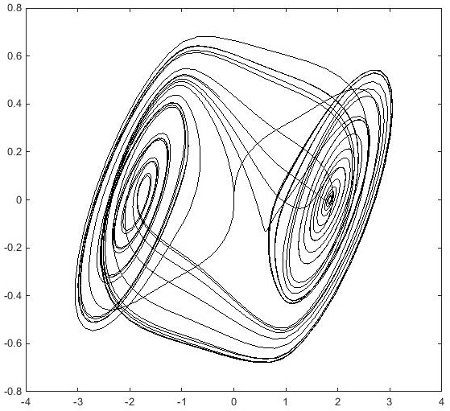
And plot them together!
Voltage across capacitor 2
Voltage across capacitor 1

Slide 21
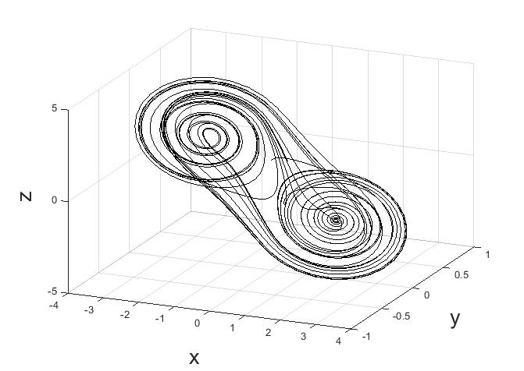
3-D phase space

Slide 22
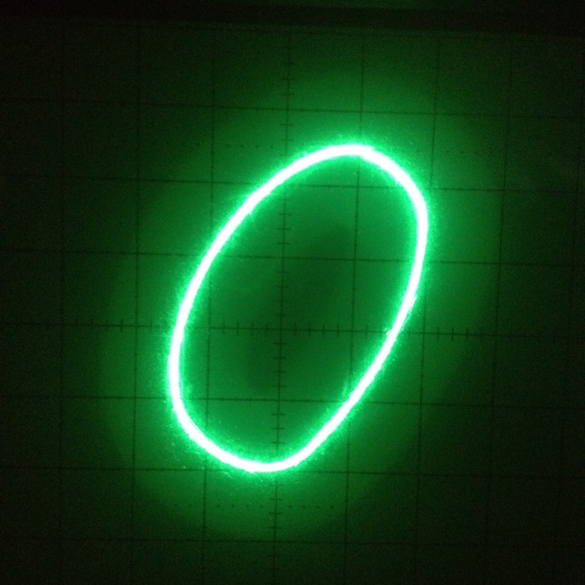
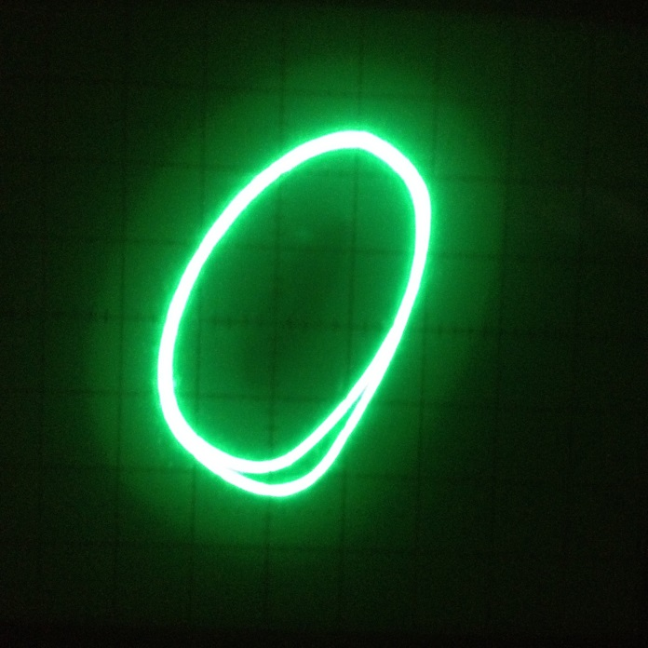
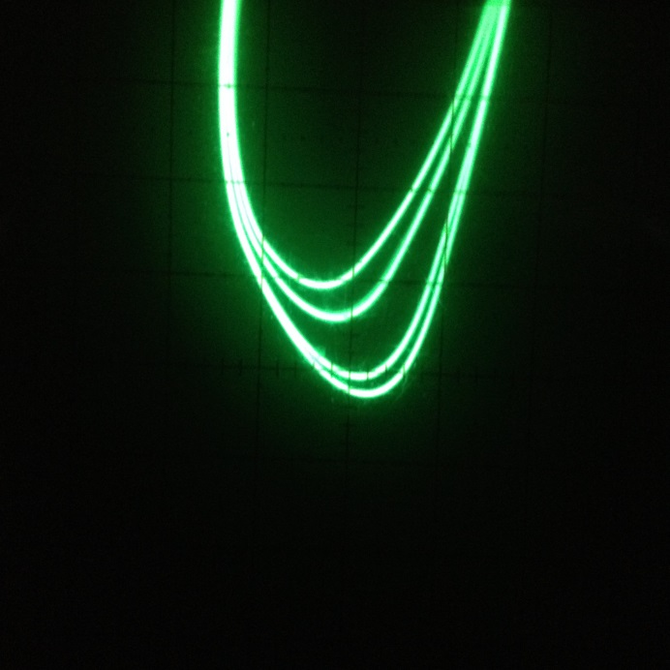
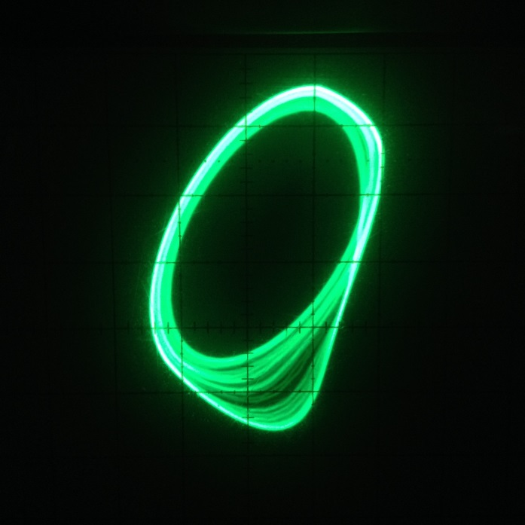
Period doubling bifurcation
Period-1
Period-2
Period-4
Chaos

Slide 23
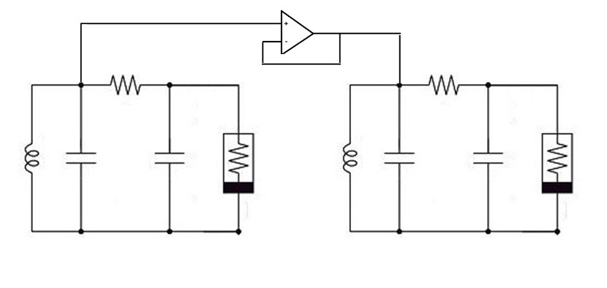
Synchronization of Chua’s Circuit
Master
Slave

Slide 24
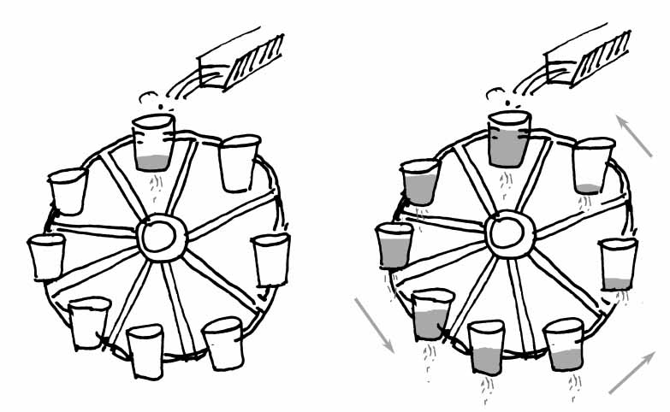
Analog computation
Waterwheel behaving according to Lorenz equations

Slide 25
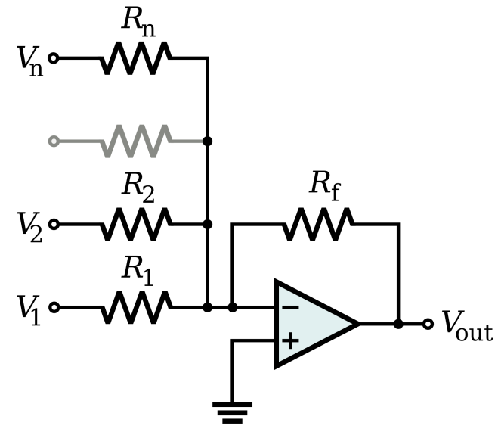
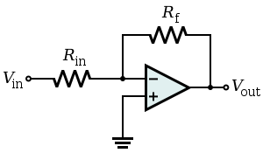
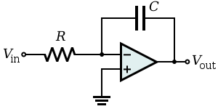
Op amp configurations
Adder
Inverter
Integrator

Slide 26
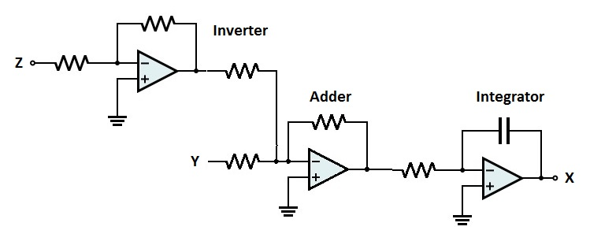
Analog computing example
Solve $\dot{x}=y−z$

Slide 27
Lorenz circuit
$$\dot{x}=σ(y−x)$$
$$\dot{y}=rx−y−xz$$
$$\dot{z}=xy−bz$$

Slide 28
Bistability in a Hyperchaotic System with a Line Equilibrium (2014)
Coauthors: (C. Li, J.C Sprott, W. Thio, )
$$\dot{x}=y−xz −yz+u$$
$$\dot{y}=a∗xz$$
$$\dot{z}=y^{2} −b∗z^{2}$$
$$\dot{u}=−c∗y$$

Slide 29
A New Piecewise Linear Hyperchaotic Circuit (2014)
Coauthors: (C. Li, J.C Sprott, W. Thio, H. Zhu)
$$\dot{x}=y−x$$
$$\dot{y}=−z∗sgn\left(x\right)+u$$
$$\dot{z}=\left|x\right|−a$$
$$\dot{u}=−b∗y$$

Slide 31
What are the applications?

Slide 32
Secure communications
Master
Slave

Slide 33
AMOS-WD06: Cockroach robot using chaos control

Slide 34
Memristors

Slide 35
References
A Concise Guide to Chaotic Electronic Circuits (Buscarino, Fortuna, Frasca, Sciuto 2014)
A New Chaotic Jerk Circuit (Sprott 2011)
A Practical Guide for Studying Chua’s Circuits (Kilic 2010)
A simple circuit implementation of a Chaotic Lorenz System (Corron 2010)
Chaos and Time Series Analysis (Sprott 2003)
Chua’s Circuit Implementations: Yesterday, Today and tomorrow (Fortuna, Frasca, Xibilia 2009)
Development of Memristor Based Circuits (Lu, Fitch 2013)
Elegant Chaos (Sprott 2010)
Three Steps to Chaos - Part I: Evolution (Kennedy 1993)
Three Steps to Chaos - Part II: A Chua’s Circuit Primer (Kennedy 1993)

