Slide 1
Artificial General Intelligence (AGI)
Bill Hibbard
Space Science and Engineering Center
A Mathematical Theory of Artificial Intelligence
REWARDS &

Slide 2
AGENT
OBSERVATIONS
ENVIRONMENT
Can the Agent Learn To Predict Observations?
Ray Solomonoff (early 1960s):
Turing’s Theory Of Computation +
Shannon’s Information Theory
Algorithmic Information Theory (AIT)

Slide 3
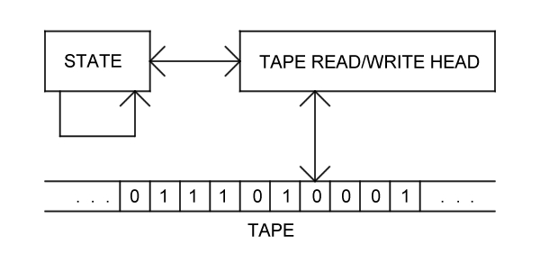
Turing Machine (TM)
Universal Turing Machine (UTM)
Tape Includes Program For Emulating Any Turing Machine

Slide 4
Probability M(x) of Binary String x is Probability That a
Randomly Chosen UTM Program Produces x
Program With Length n Has Probability 2^{-n}
Programs Are Prefix-Free So Total Probability is ≤ 1
Given Observed String x, Predict Next Bit By Larger
of M(0|x)=M(x0)/M(x) and M(1|x)=M(x1)/M(x)

Slide 5
Given a computable probability distribution μ(x) on
strings x, define (here l(x) is the length of x):
E_{n} = Σ_{l(x)=n-1} μ(x)(M(0|x)-μ(0|x))².
Solomonoff showed that Σ_{n} E_{n} ≤ K(μ) ln2/2 where
K(μ) is the length of the shortest UTM program
computing μ (the Kolmogorov complexity of μ).

Slide 6
Solomonoff Prediction is Uncomputable Because
of Non-Halting Programs
Levin Search: Replace Program Length n by
n + log(t) Where t is Compute Time
Then Program Probability is 2^{-n} / t
So Non-Halting Programs Converge to Probability 0

Slide 7
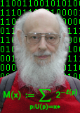
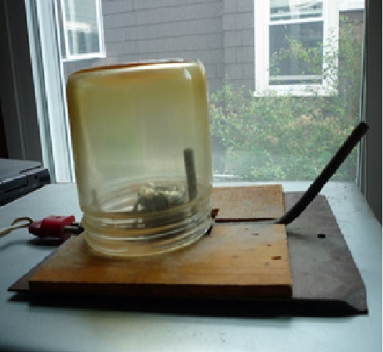
1-2-3-4 kick the lawsuits out the door
5-6-7-8 innovate, don't litigate
9-A-B-C interfaces should be free
D,E,F,0 look and feel has got to go!
Ray Solomonoff
Allen Ginsberg

Slide 8
Extending AIT to Agents That Act On The Environment
REWARDS &
Marcus Hutter (early 2000’s):
AIT + Sequential Decision Theory
Universal Artificial Intelligence (UAI)

Slide 9
Finite Sets of Observations, Rewards and Actions
Define Solomonoff’s M(x) On Strings x Of Observations,
Rewards and Actions To Predict Future Observations
And Rewards
Agent Chooses Action That Maximizes Sum Of Expected
Future Discounted Rewards

Slide 10
Hutter showed that UAI is Pareto optimal:
If another AI agent S gets higher rewards than UAI
on an environment e, then S gets lower rewards
than UAI on some other environment e’.

Slide 11
Hutter and His Student Shane Legg Used This Framework
To Define a Formal Measure Of Agent Intelligence,
As the Average Expected Reward From Arbitrary
Environments, Weighted By the Probability Of UTM
Programs Generating The Environments
Legg Is One Of the Founders Of Google DeepMind,
Developers Of AlphaGo and AlphaZero

Slide 12
Hutter’s Work Led To the Artificial General Intelligence
(AGI) Research Community
The Series Of AGI Conferences, Starting in 2008
The Journal of Artificial General Intelligence
Papers and Workshops at AAAI and Other Conferences

Slide 13
Laurent Orseau and Mark Ring (2011) Applied This
Framework To Show That Some Agents Will Hack
Their Reward Signals
Human Drug Users Do This
So Do Lab Rats Who Press Levers To Send Electrical
Signals To Their Brain’s Pleasure Centers
(Olds & Milner 1954)
Orseau Now Works For Google DeepMind

Slide 14
Very Active Research On Ways That AI Agents May
Fail To Conform To the Intentions Of Their
Designers
And On Ways To Design AI Agents That Do Conform
To Their Design Intentions
Seems Like a Good Idea

Slide 15
Bayesian Program Learning Is Practical Analog Of
Hutter’s Universal AI
2016 Science Paper: Human-level Concept Learning
Through Probabilistic Program Induction, by
B. M. Lake, R. Salakhutdinov & J. B. Tenenbaum
Much Faster Than Deep Learning

Slide 16
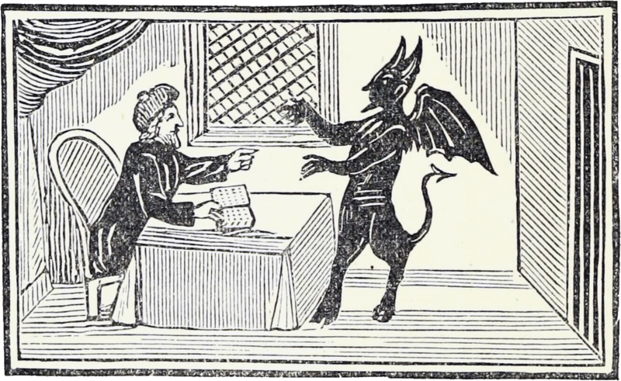

Slide 17
Thank you

